Slide 1
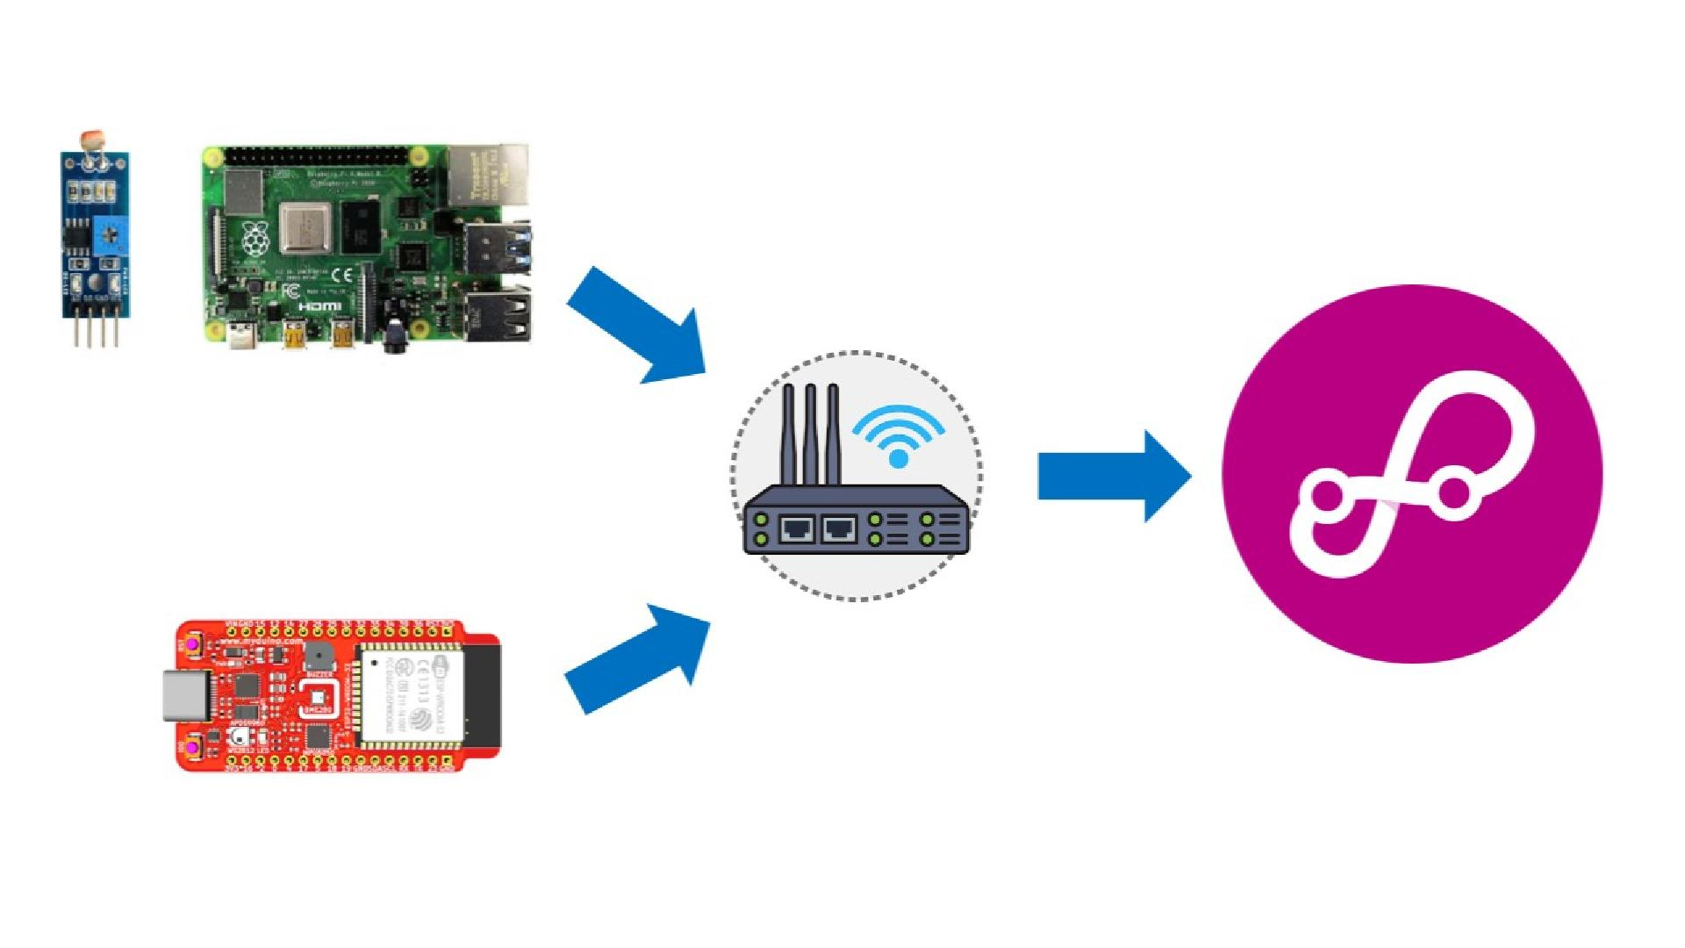

Slide 2
1
CREATE DEVICE
2
CREATE EDGE GATEWAY
3
ESP32 SETUP
4
RASPBERRY PI SETUP
5
GATEWAY CONSOLE

Slide 3
CREATE DEVICE

Slide 4
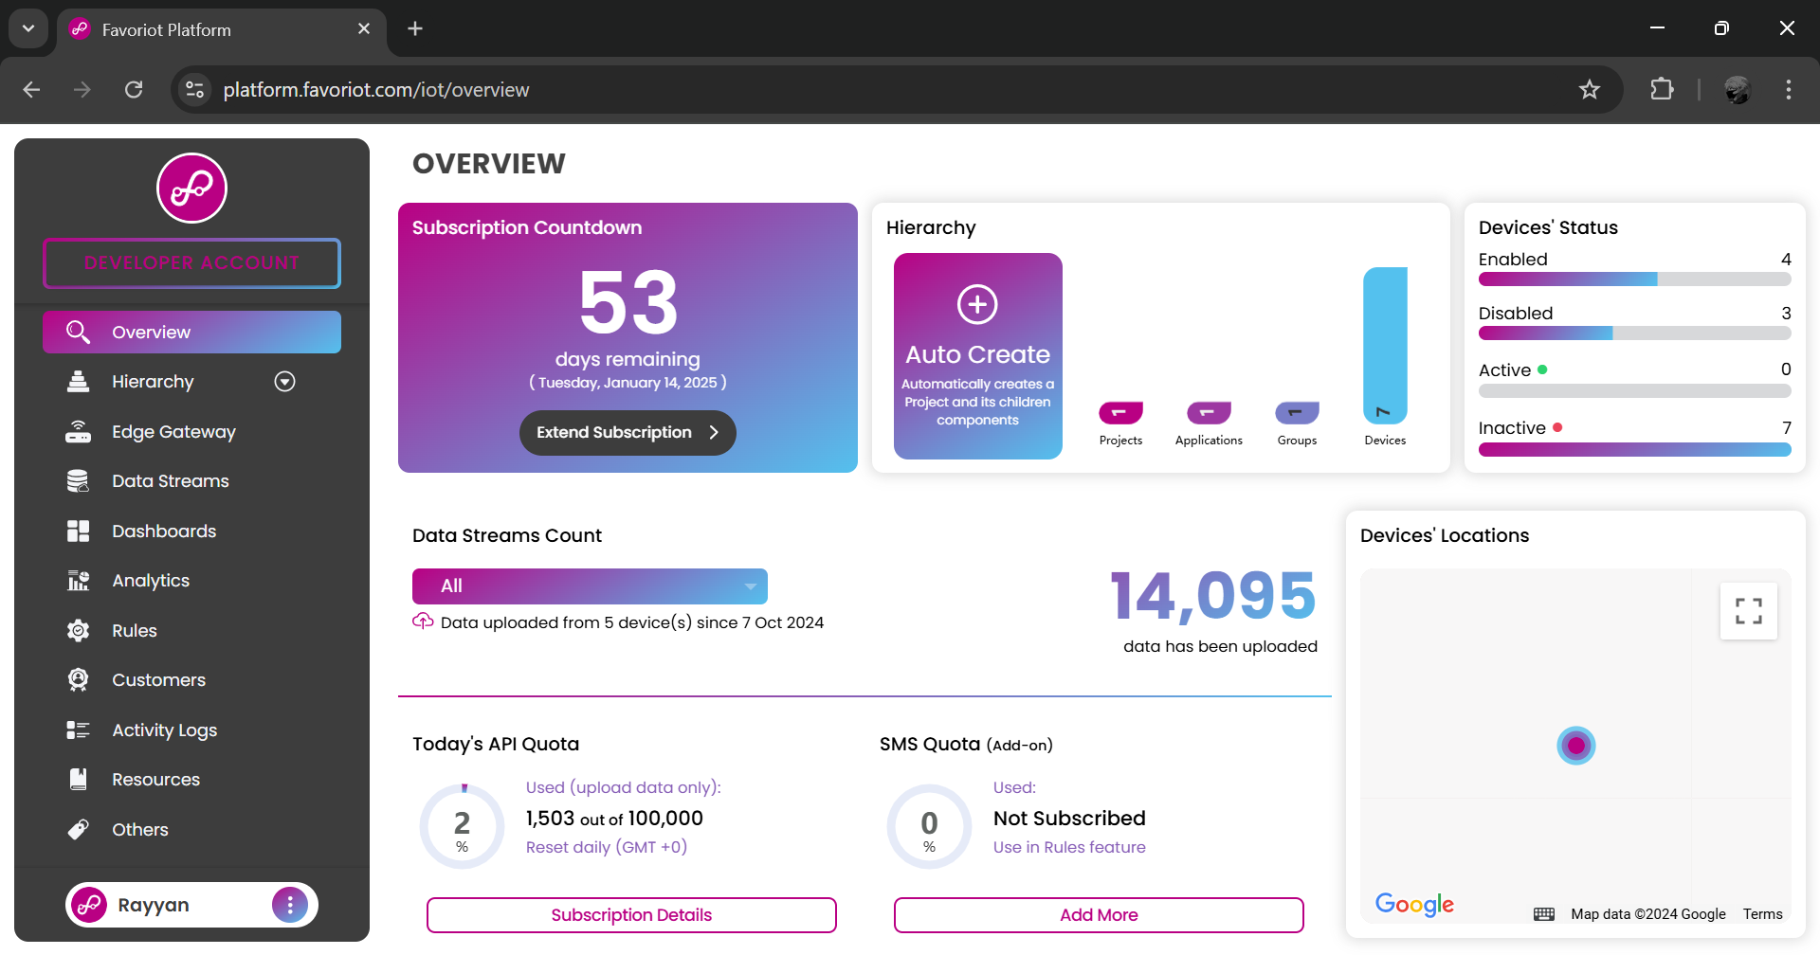
1
Log in to Favoriot account. Then, click hierarchy to open device page.

Slide 5

1
Click devices.

Slide 6
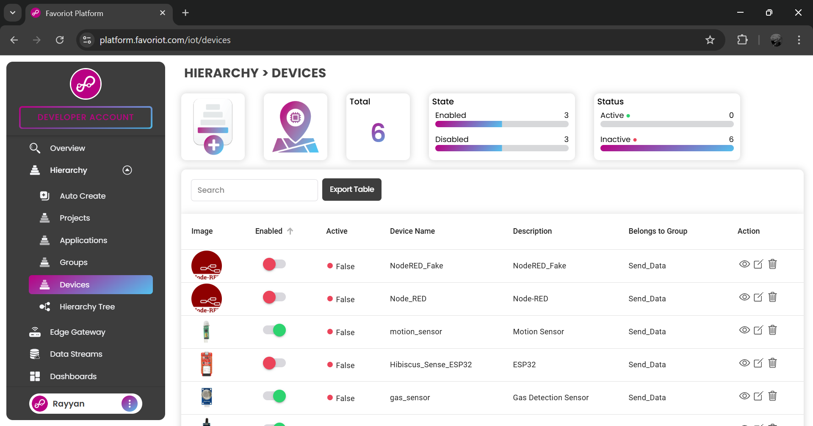
1
Create new device.

Slide 7
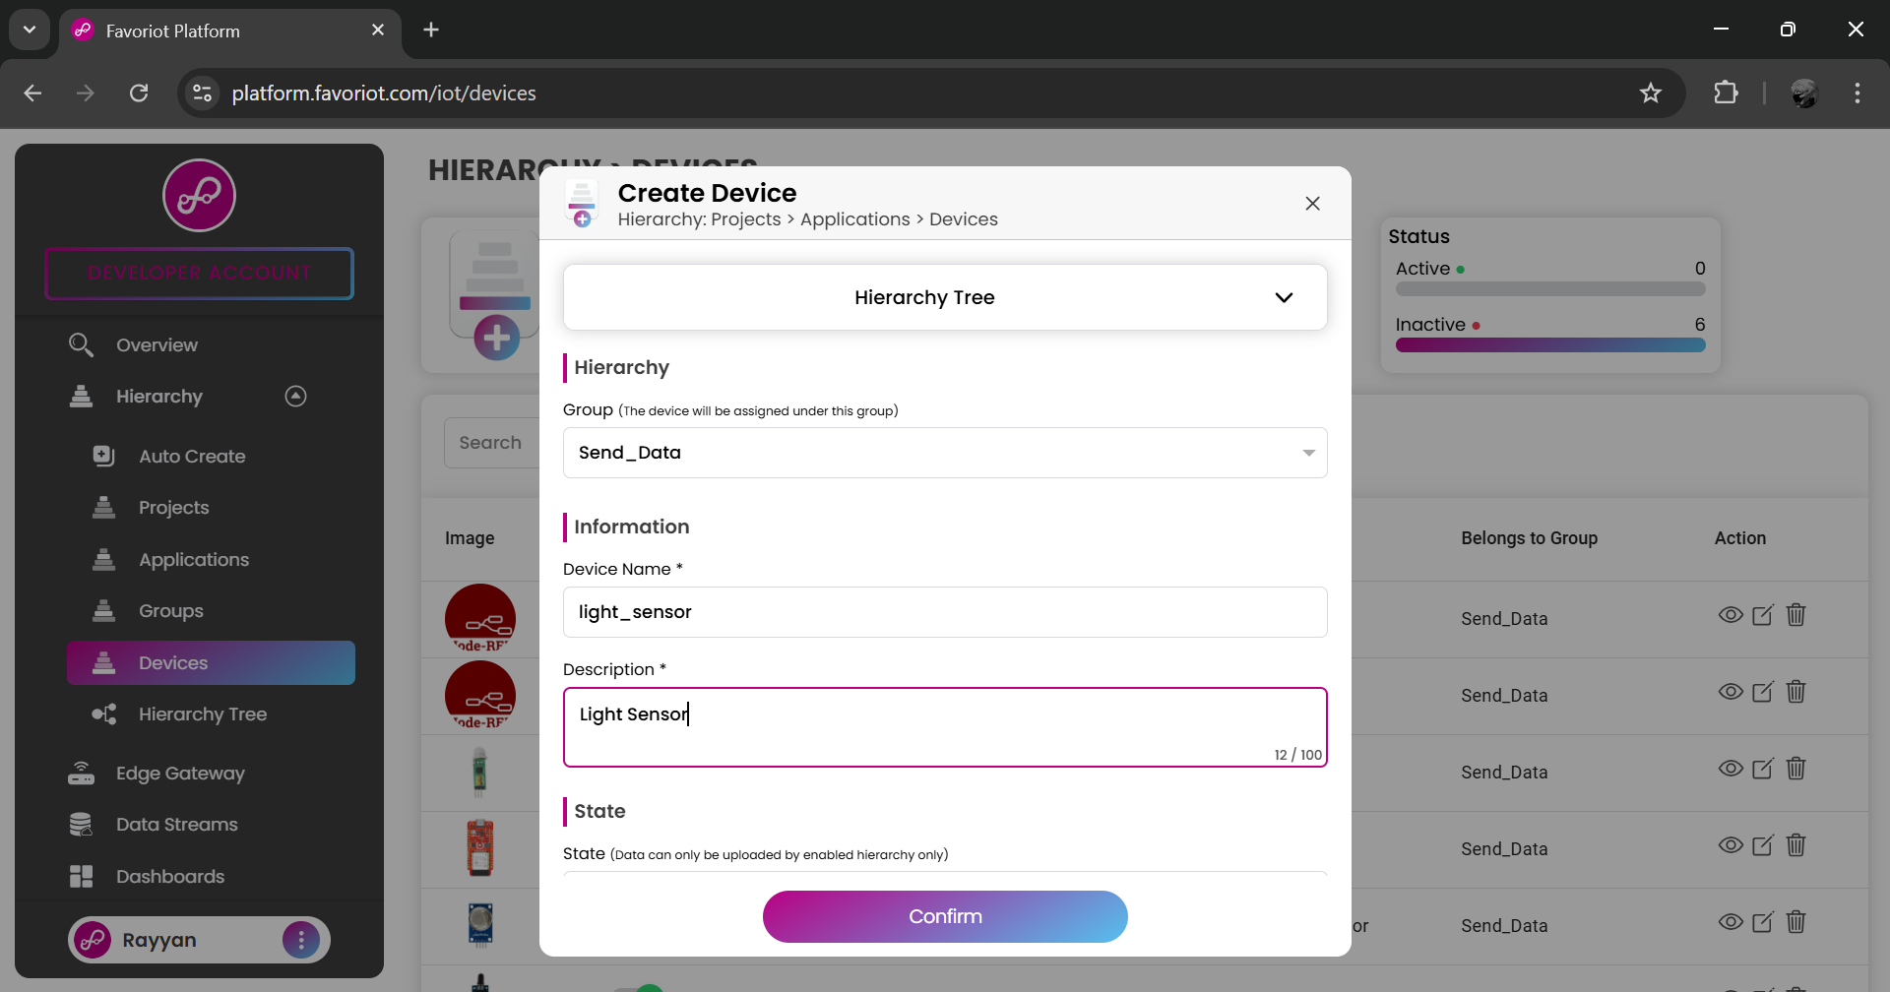
1
Select group.
2
Put device’s name and its description.
3

Slide 8
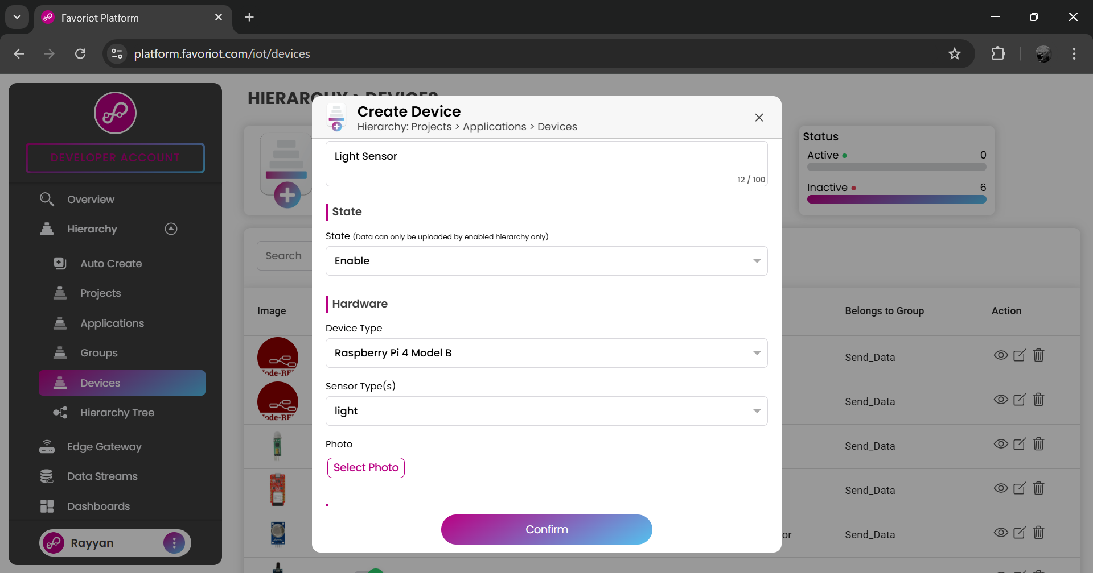
1
Click enable to enable the device.
2
Select device’s type. Then, select sensor’s type.
3
4
Upload the device’s photo.

Slide 9
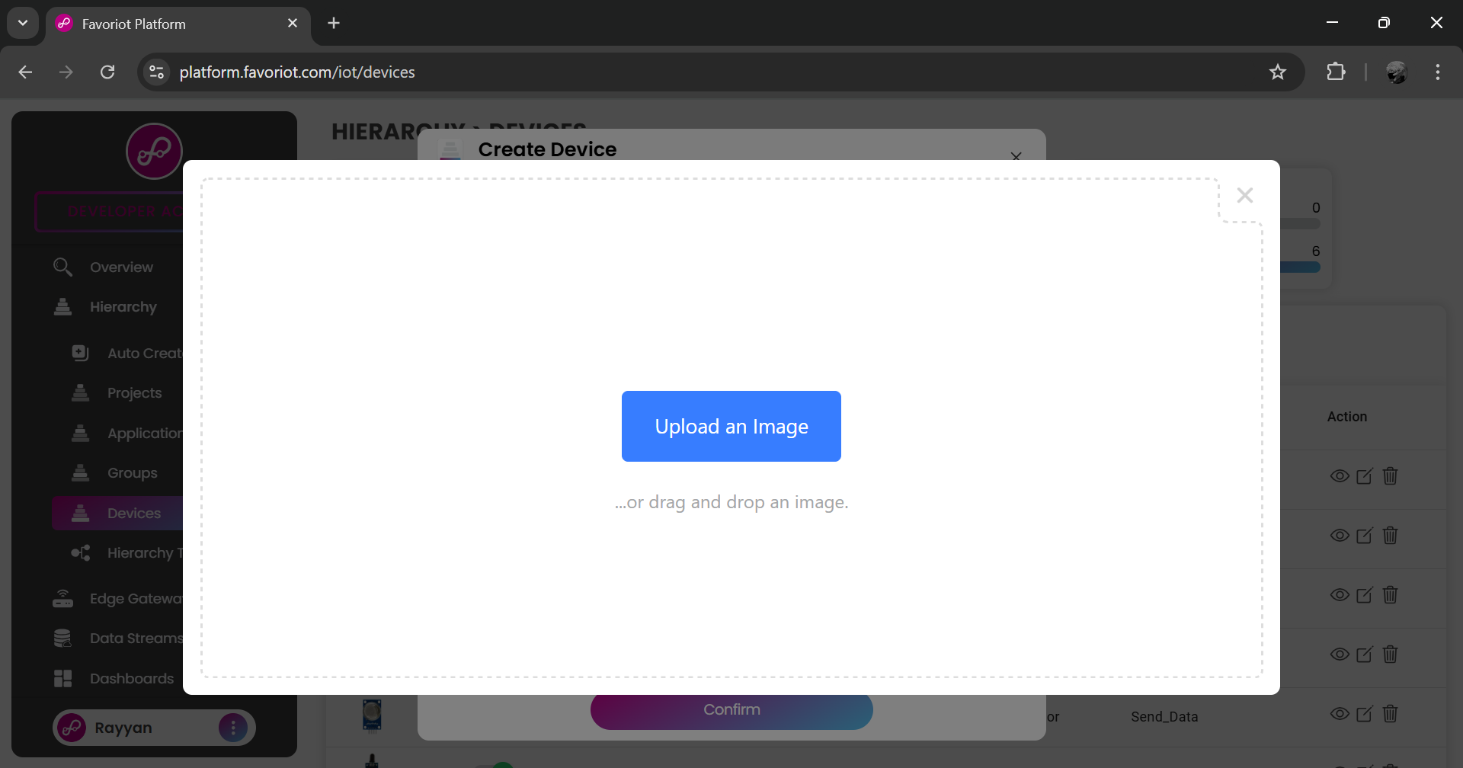
1
Upload an image.

Slide 10
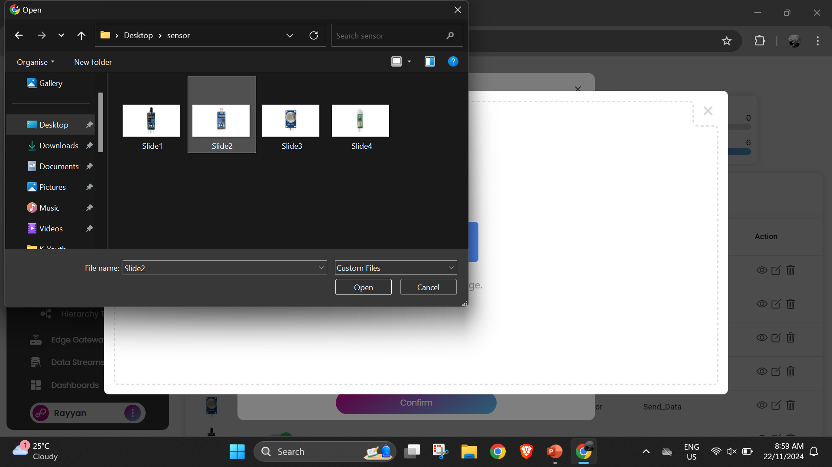
1
Select device’s picture.
2
Then, upload the picture.

Slide 11
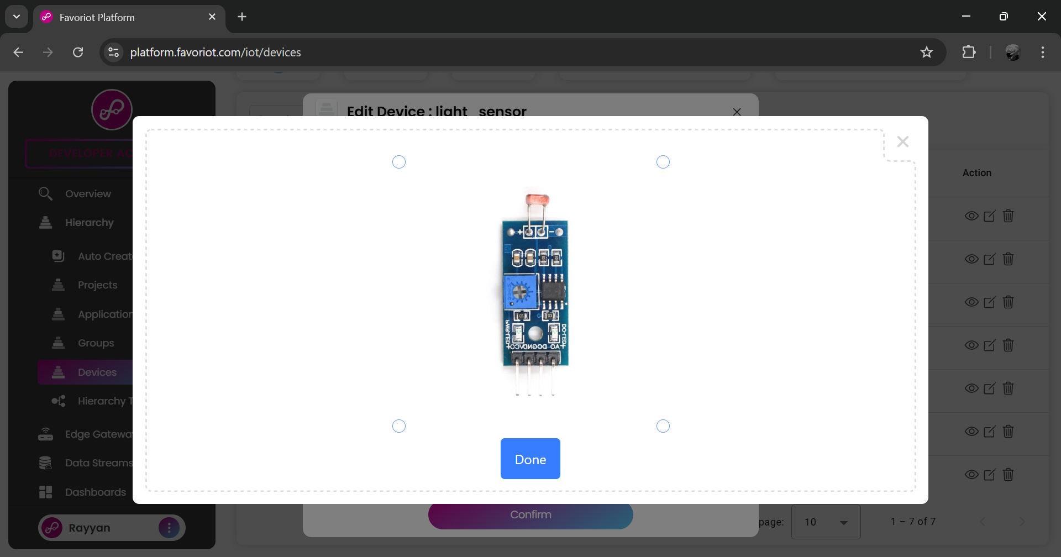
1
Then, click done.

Slide 12
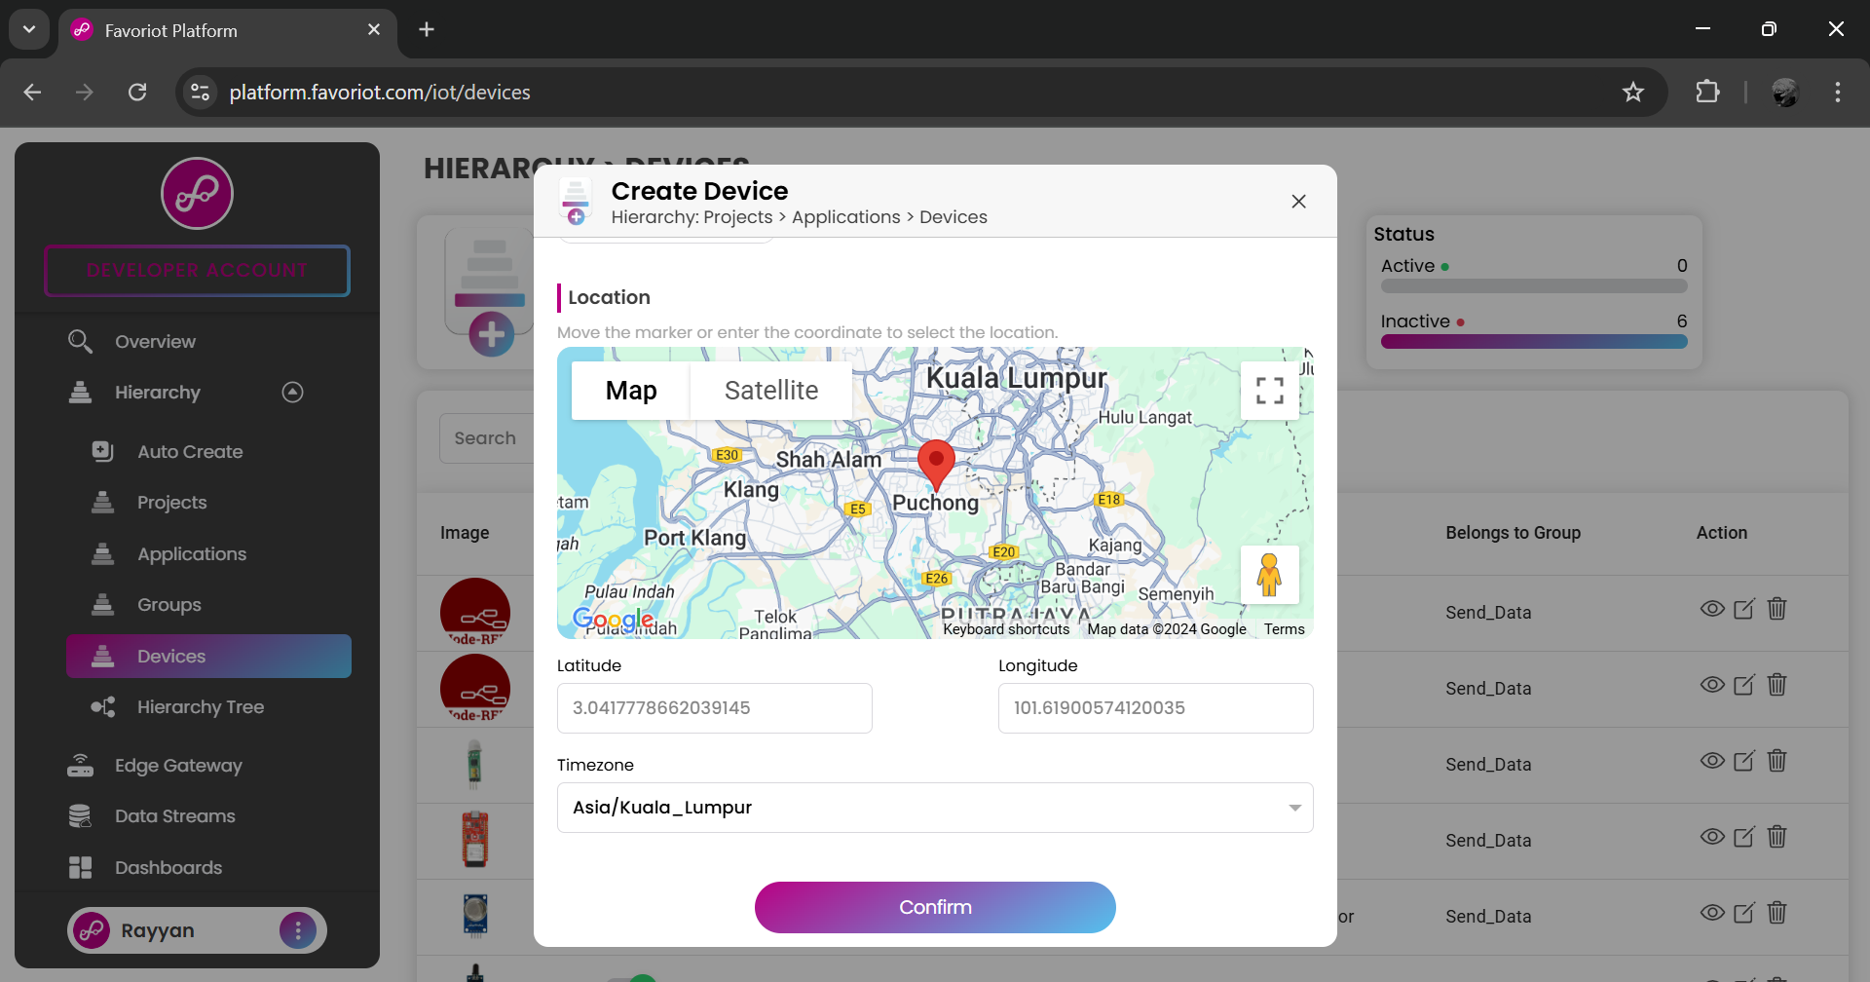
1
Select time zone and click confirm.
2

Slide 13
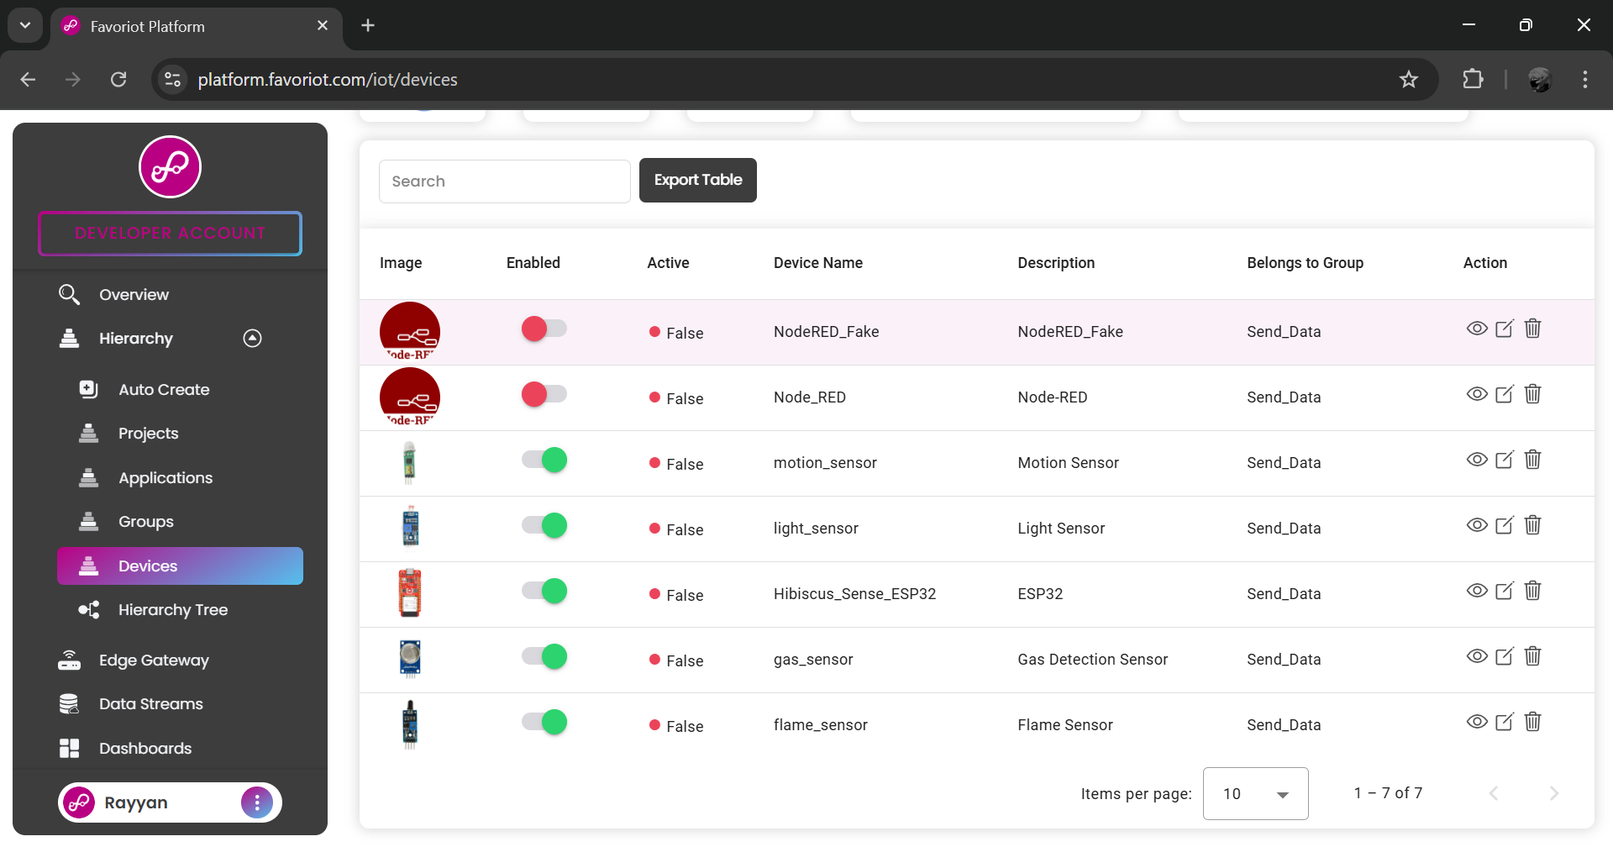
Also create device for Hibiscus Sense ESP32.
1
2
Then, click Edge Gateway.

Slide 14
CREATE EDGE GATEWAY

Slide 15
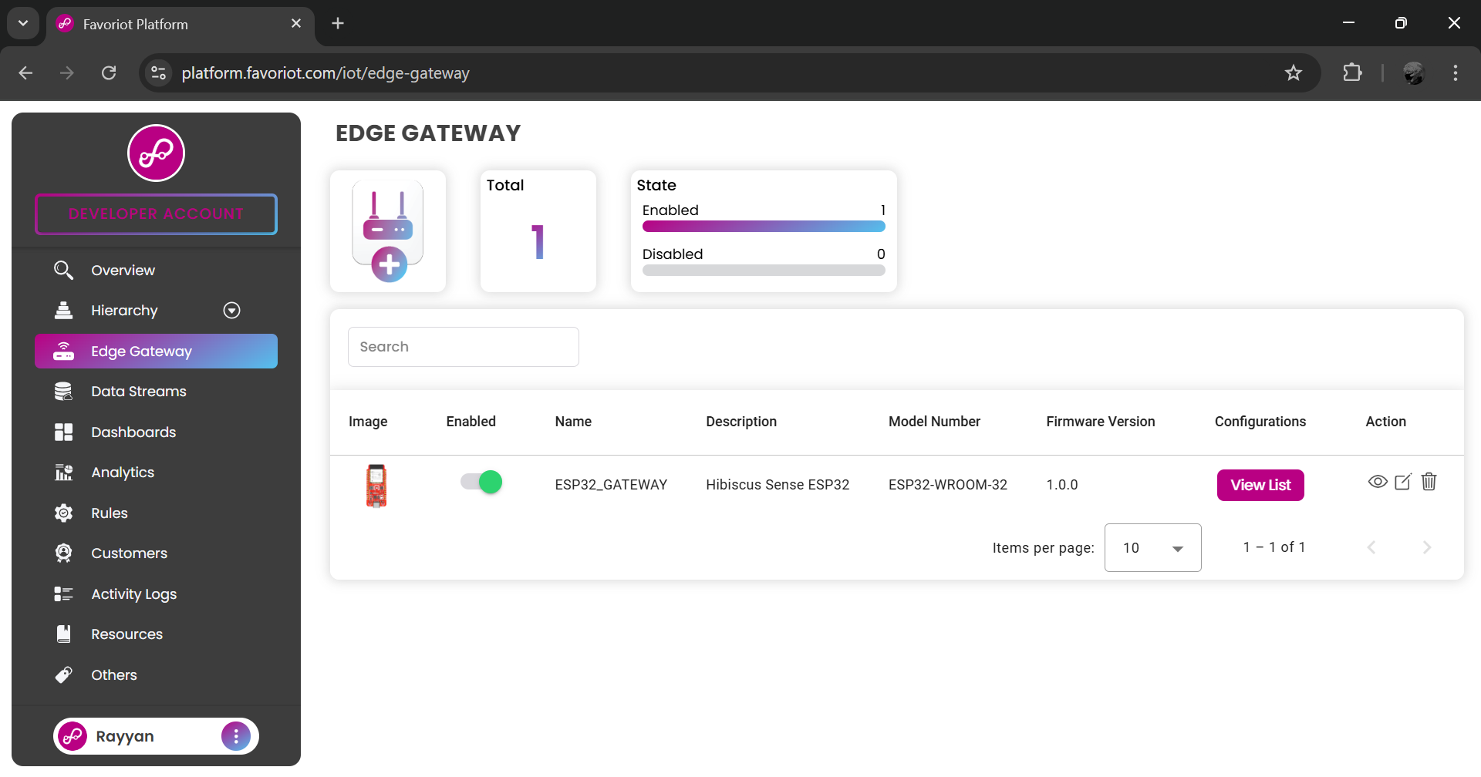
1
Create new gateway.

Slide 16
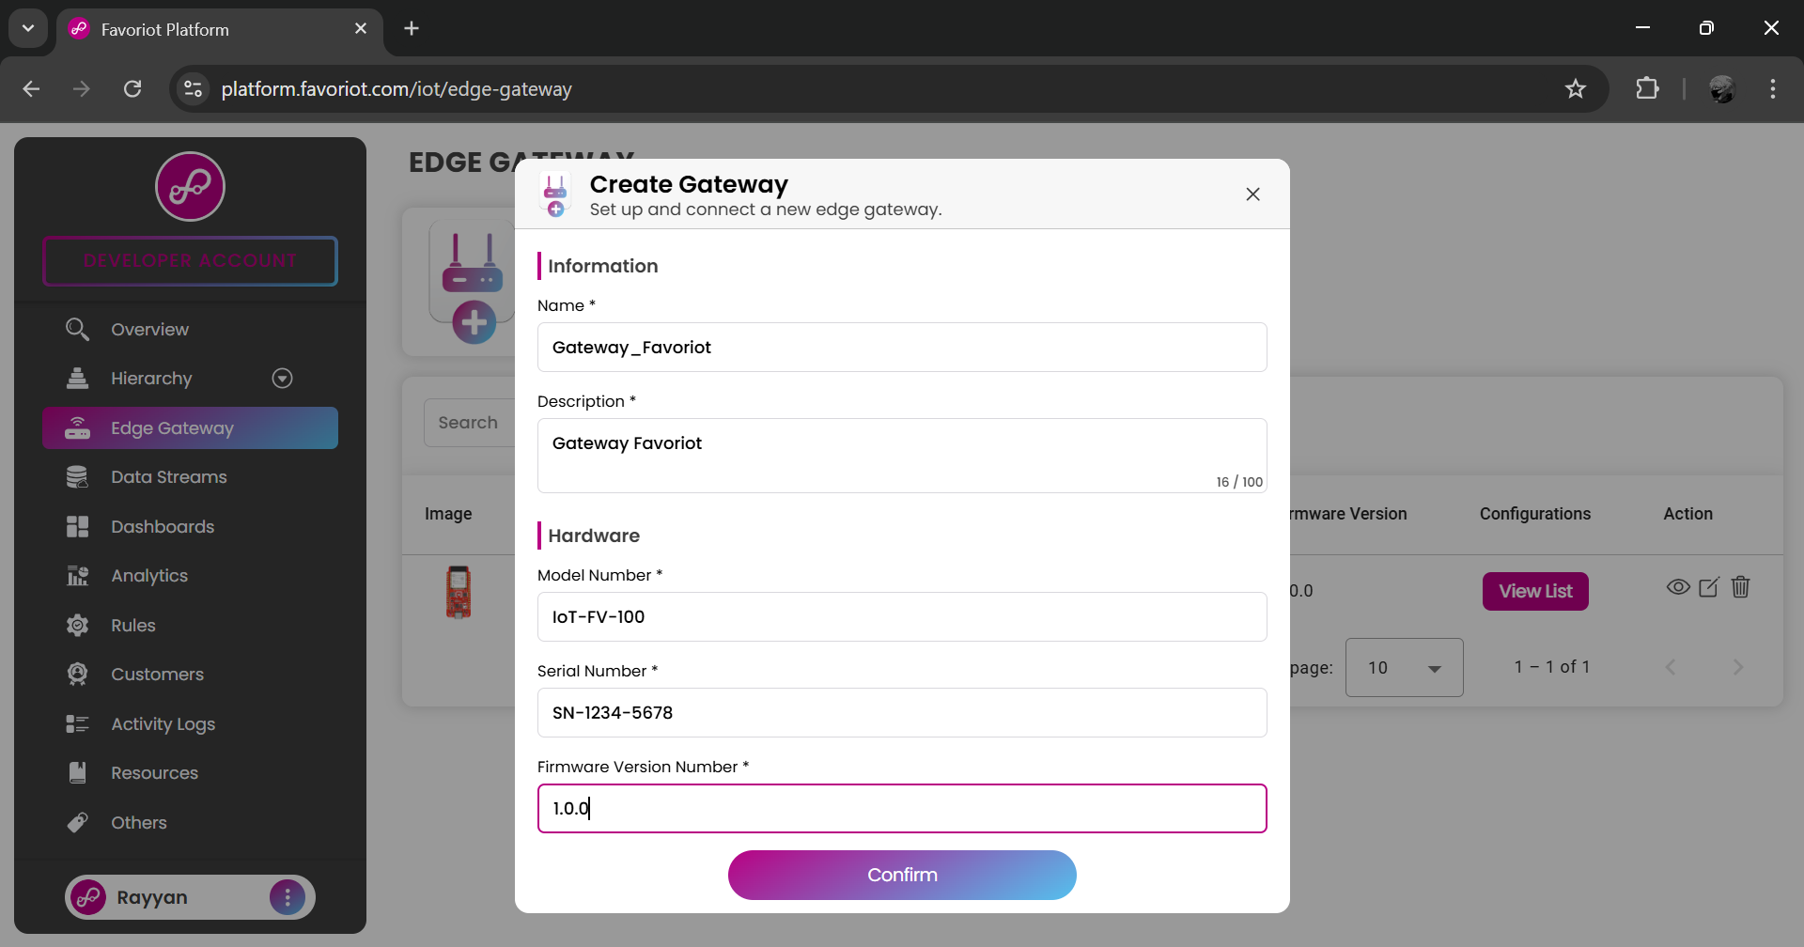
Insert all the required information.
1
2
3
4
5

Slide 17
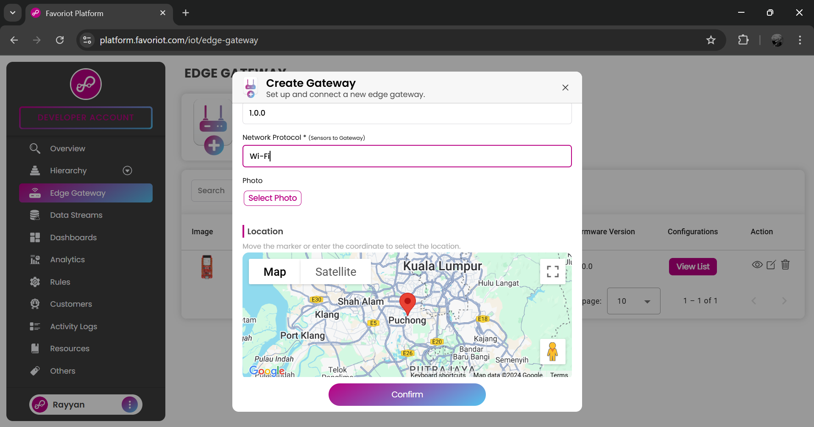
1
Also insert the network protocol. Then, upload gateway’s photo.
2

Slide 18
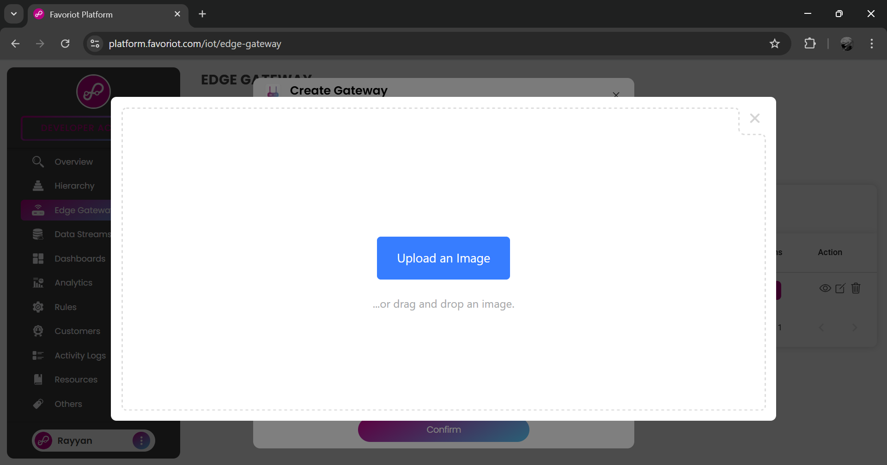
1
Upload an image.

Slide 19
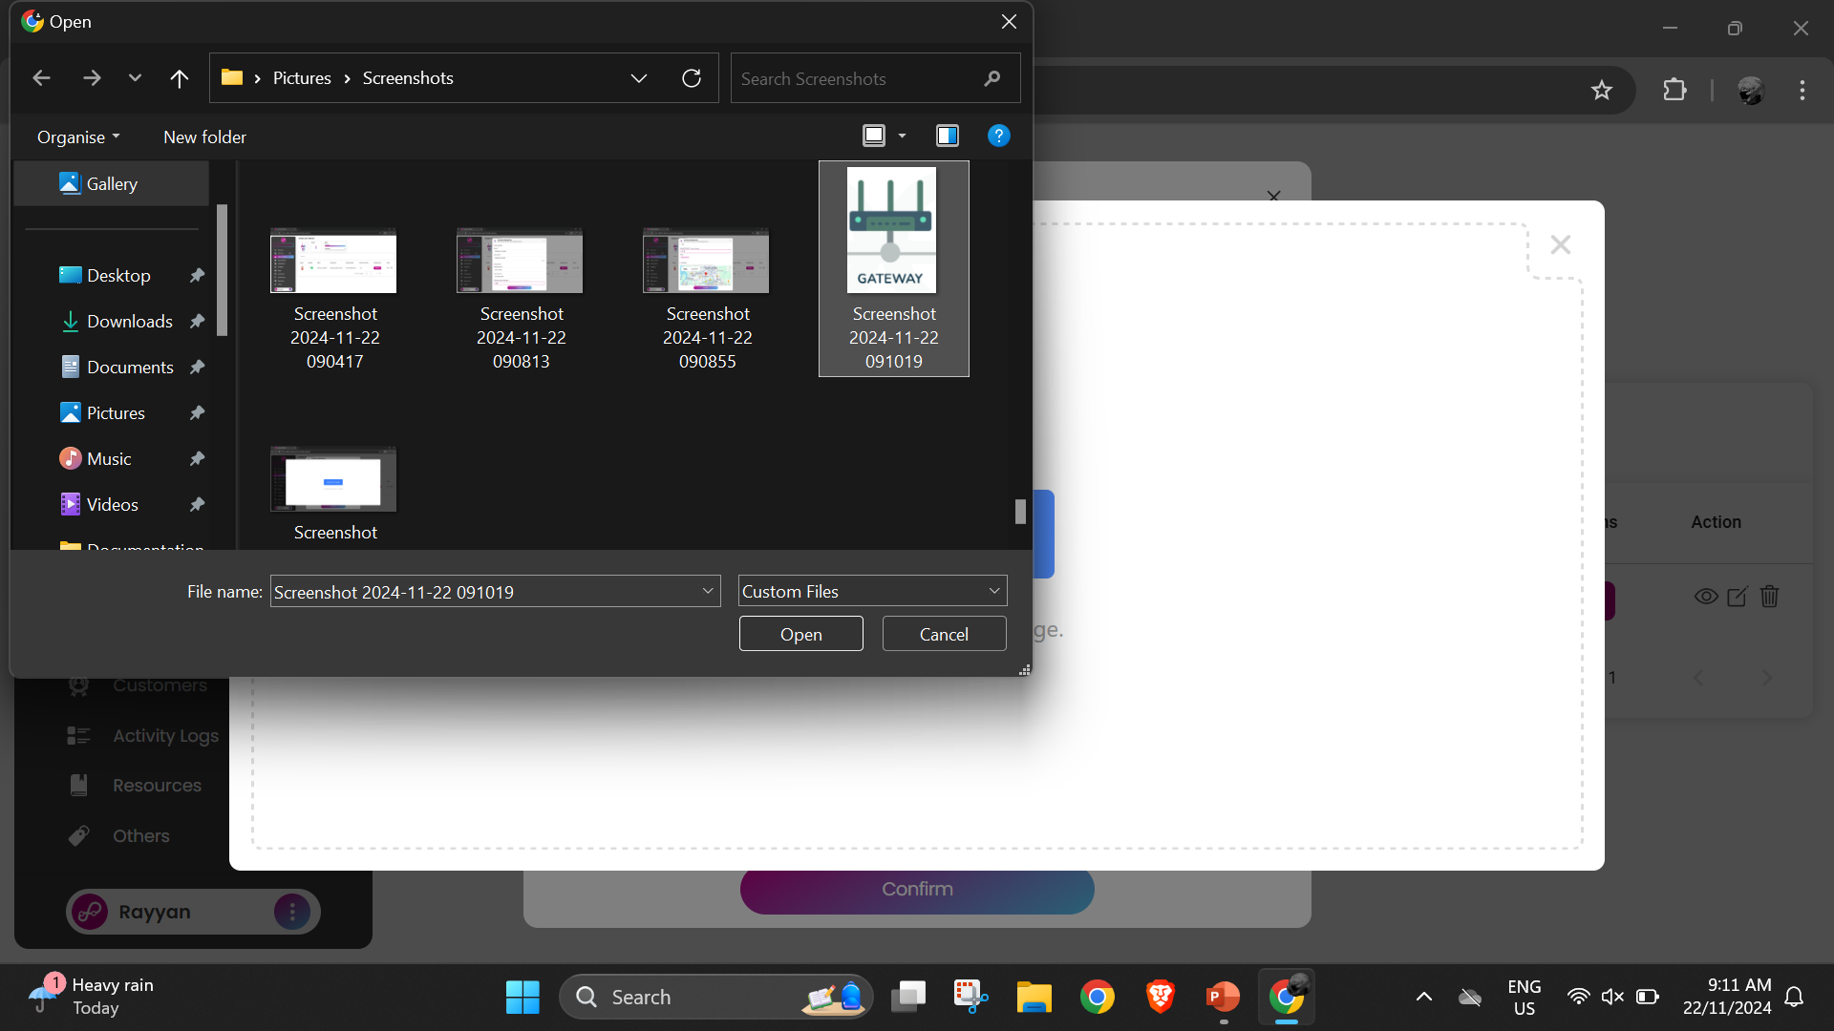
1
Select image and upload it.
2

Slide 20
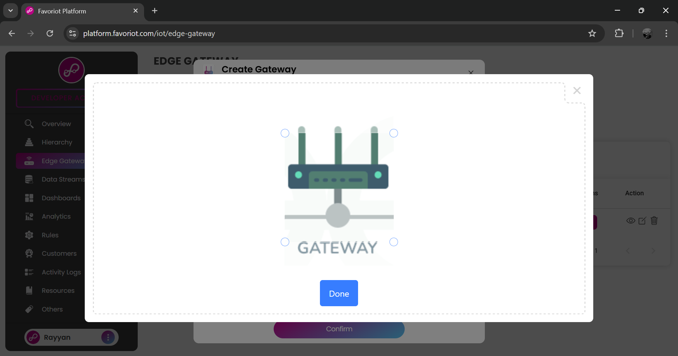
1
Click done.

Slide 21
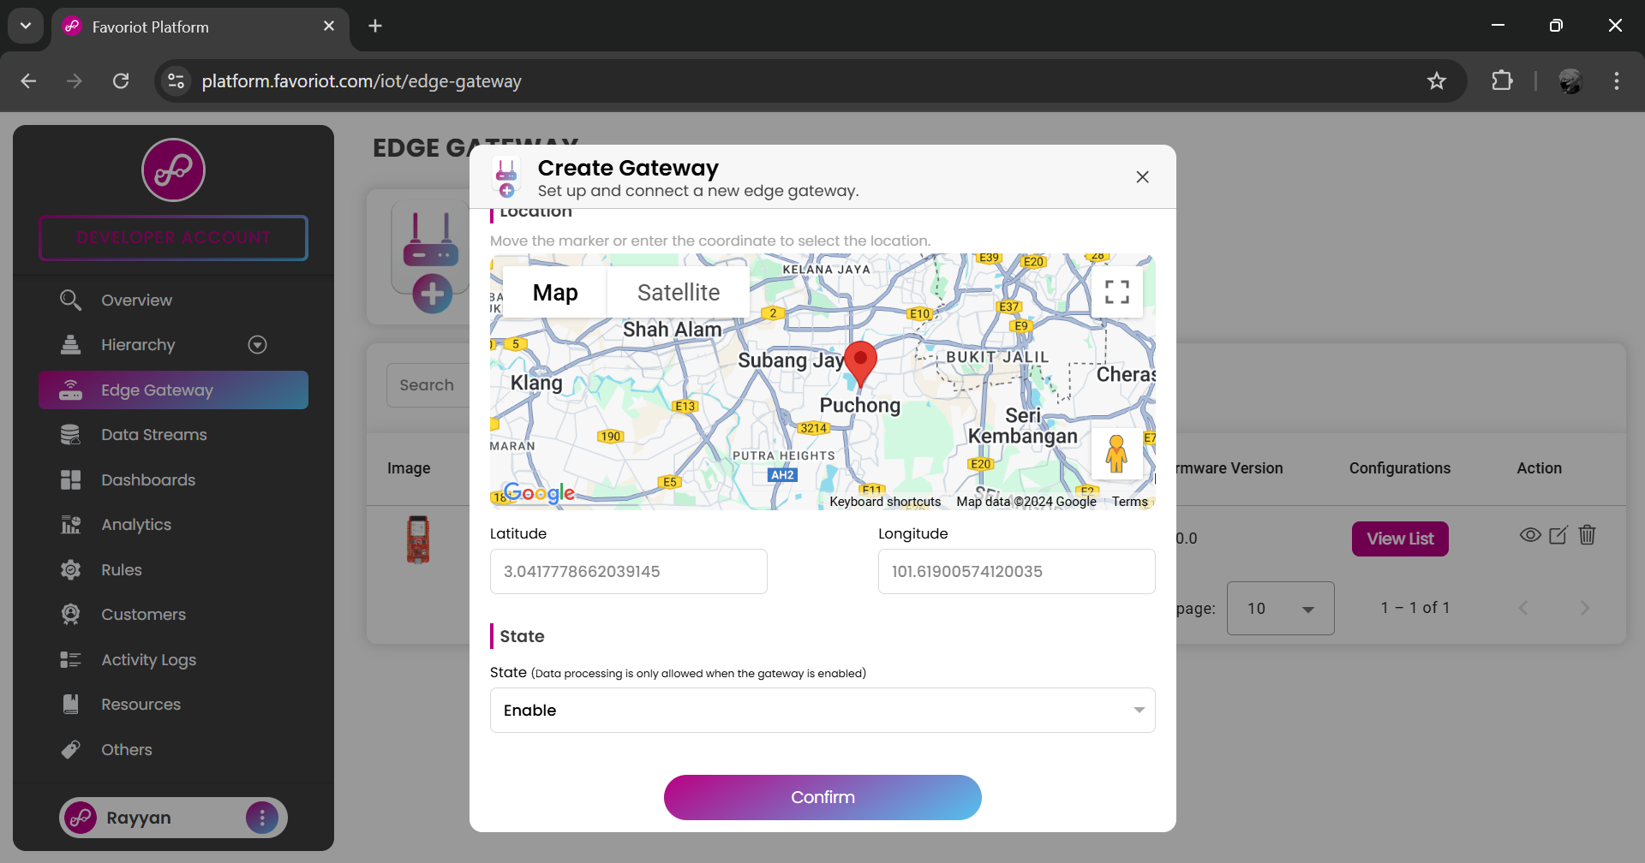
1
Then, enable the gateway and click confirm.
2

Slide 22
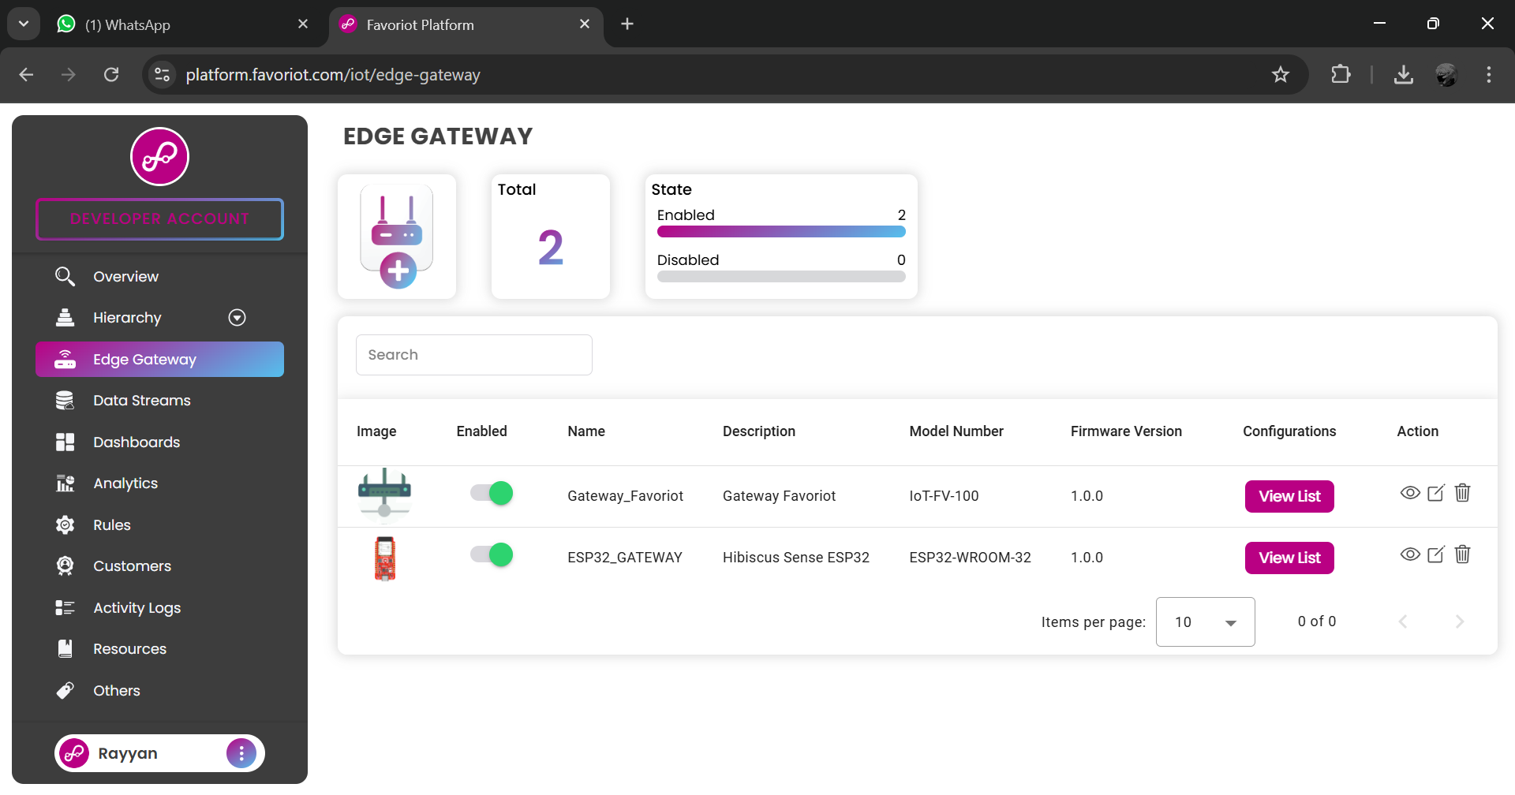
1
Click view list.

Slide 23
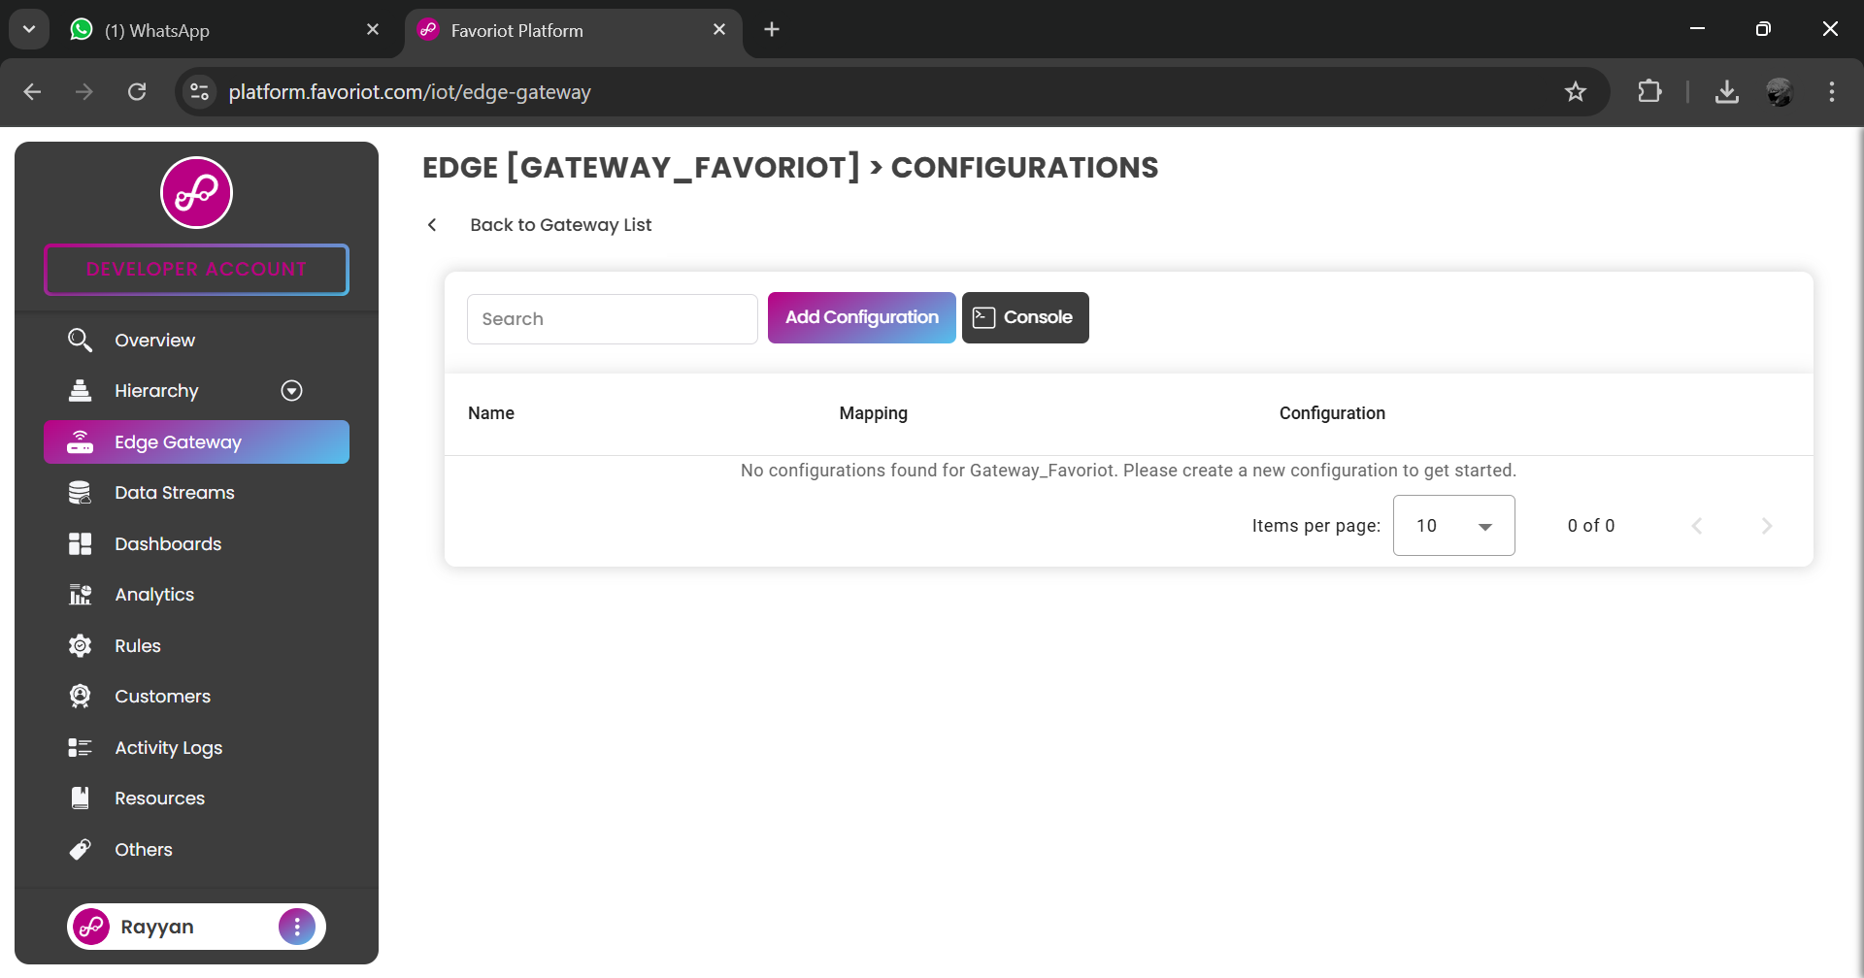
1
Add configuration.

Slide 24
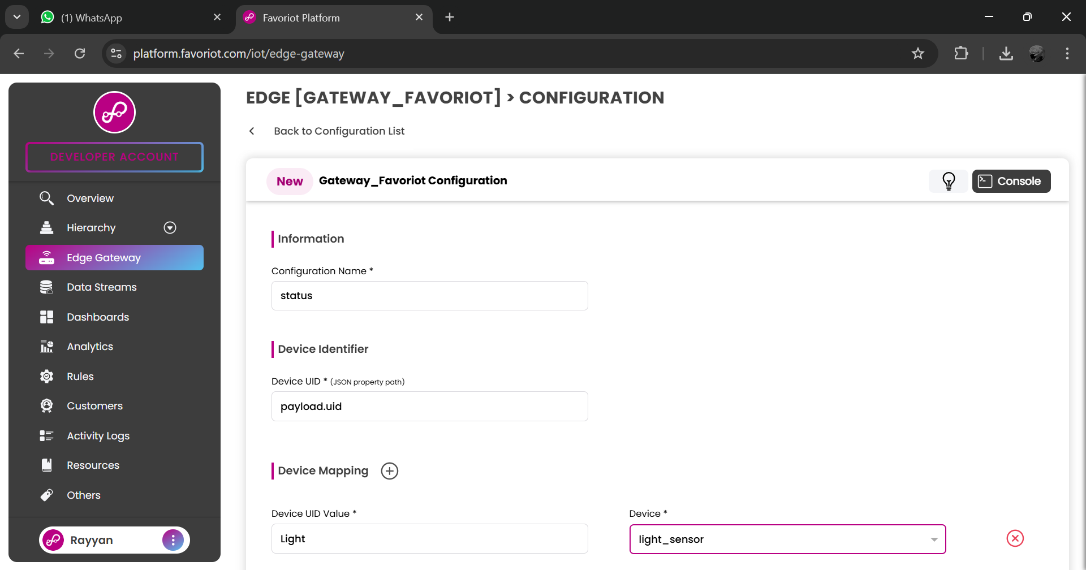
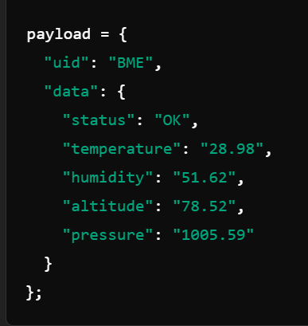
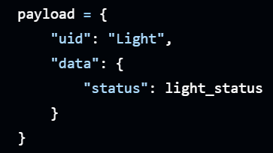
ESP32.
Raspberry Pi.
Insert configuration name.
1
2

Slide 25
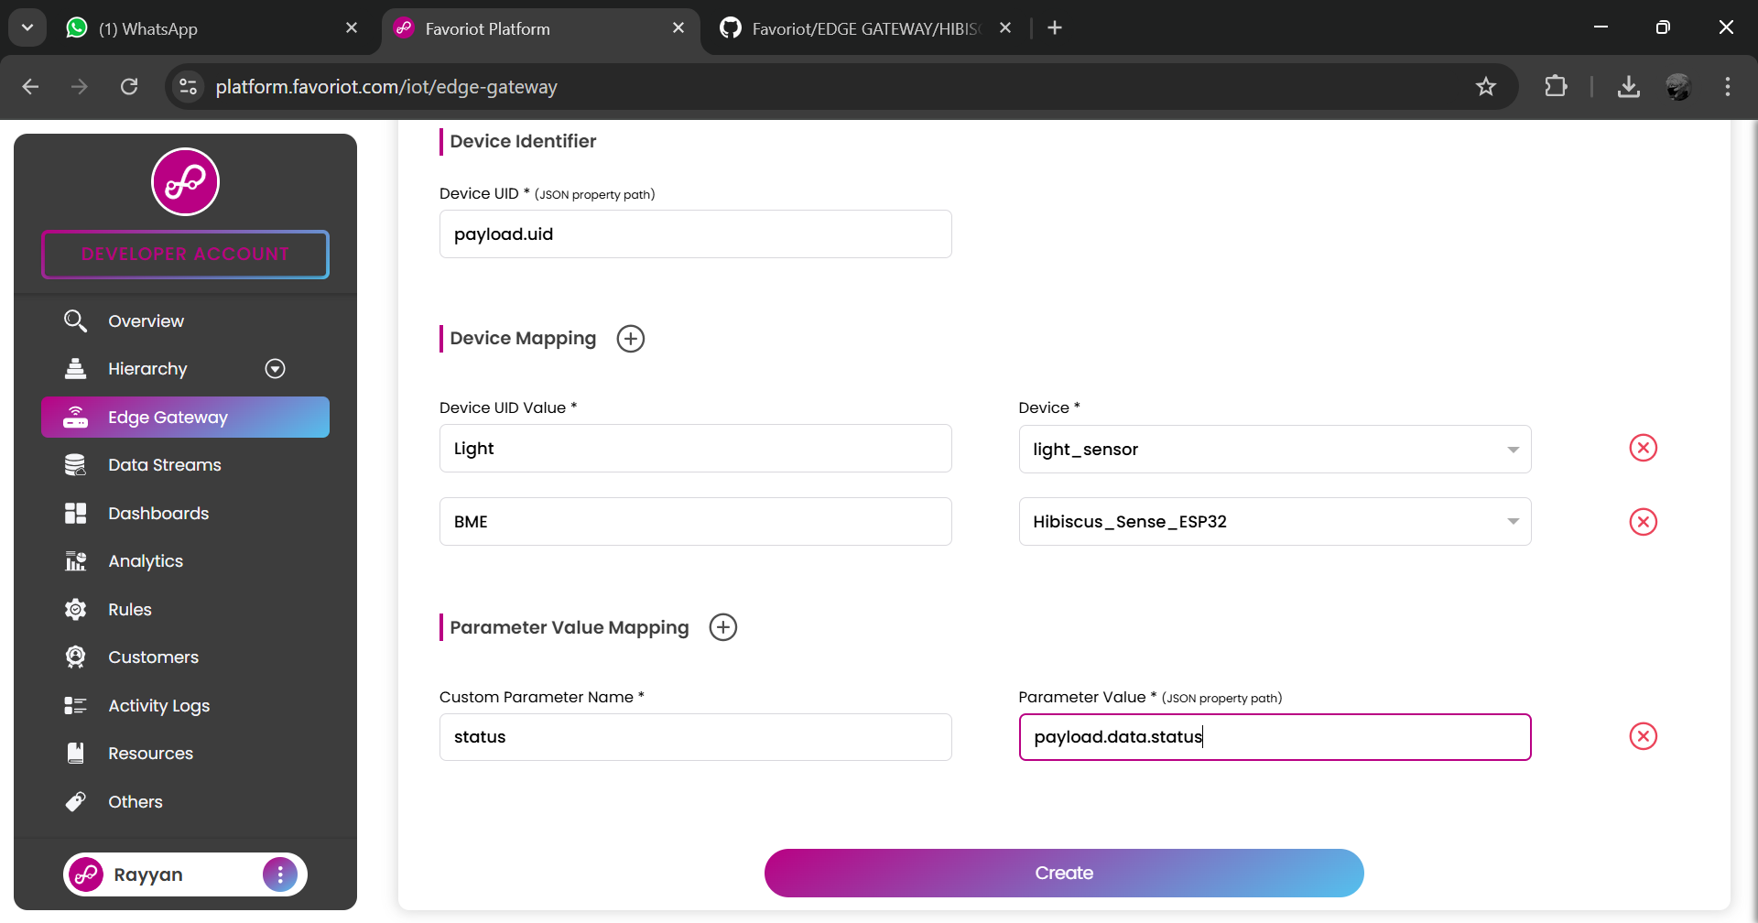
Raspberry Pi.
Insert device UID. Then, select the device.
ESP32.
1
2
Insert the parameter that need to be sent to data stream. The parameter need to be same for both device.
3
4

Slide 26
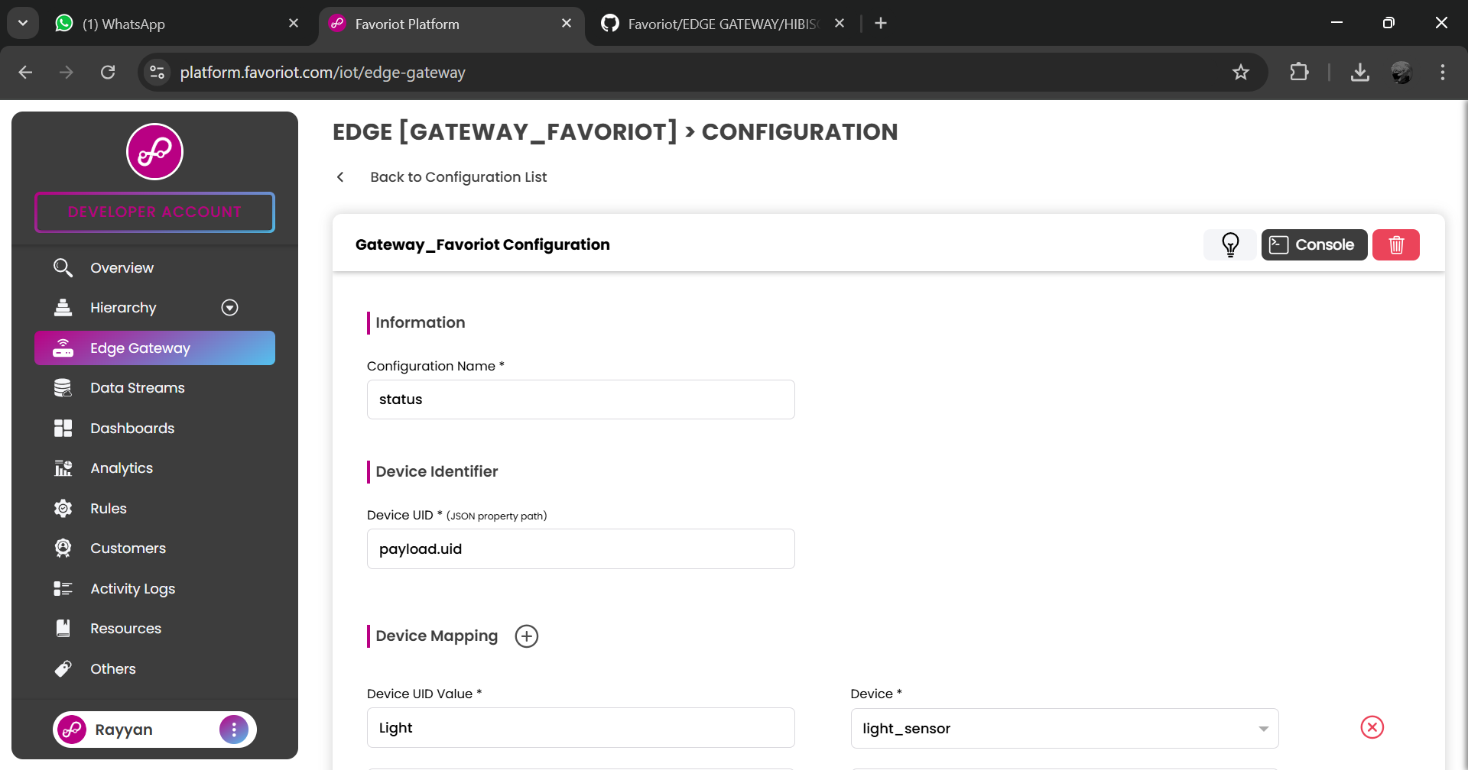
1
Back to Configuration List.

Slide 27
ESP32 SETUP

Slide 28
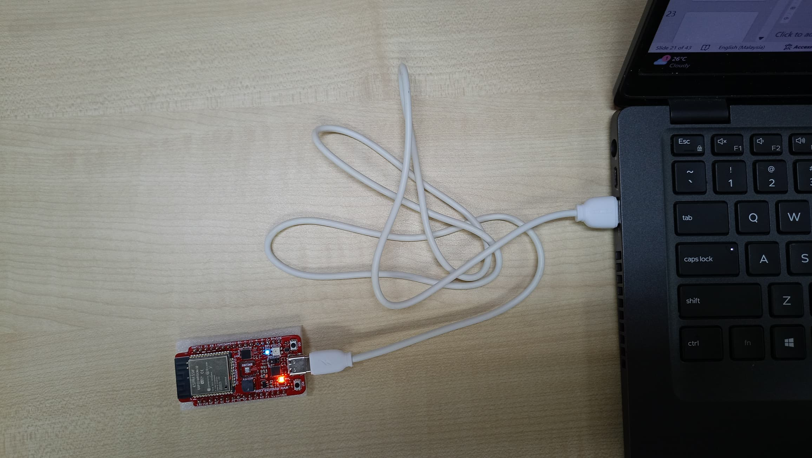
Connect Hibiscus Sense ESP32 to laptop.

Slide 29
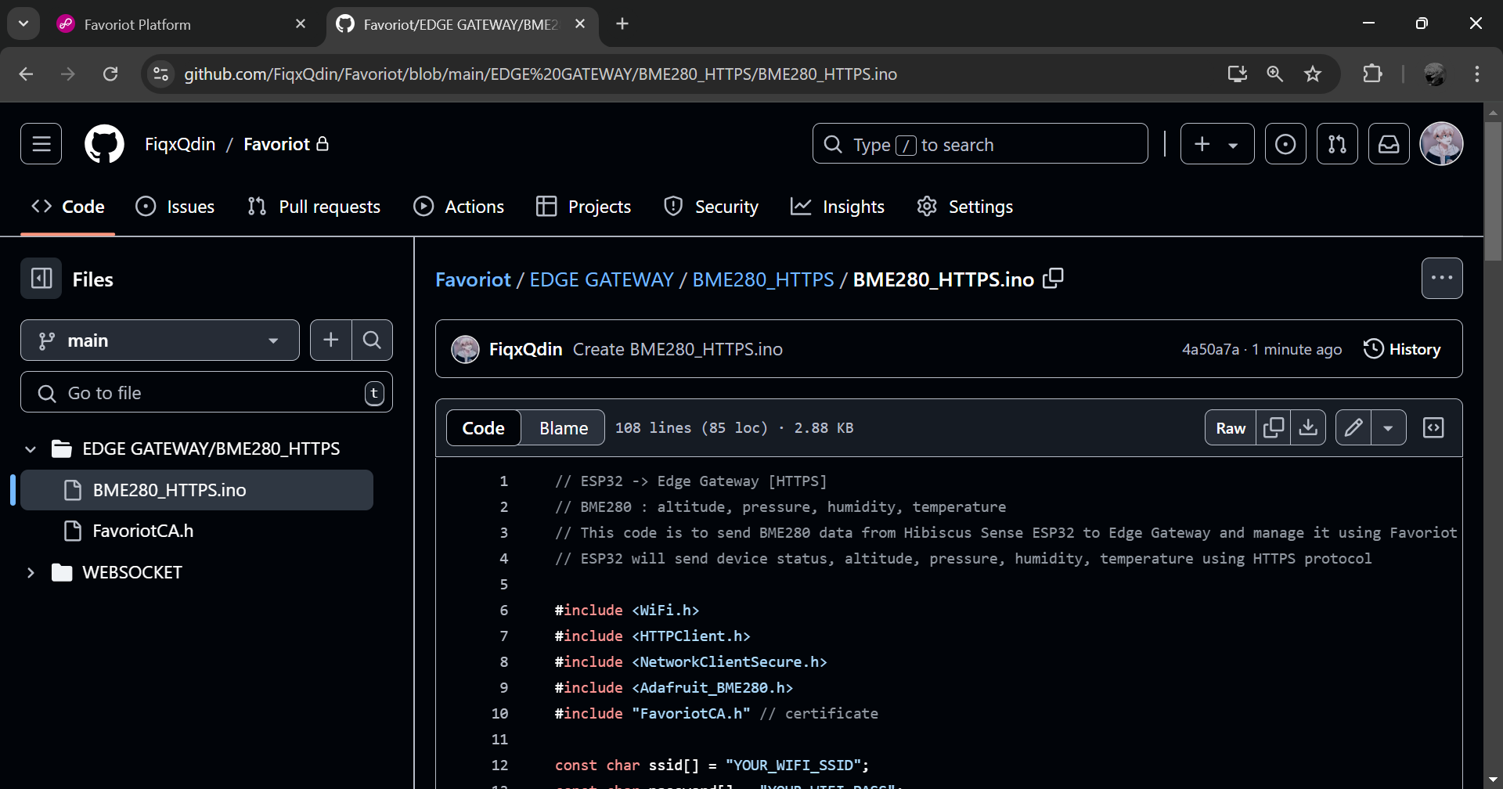
Open GITHUB (https://github.com/FiqxQdin/Favoriot/blob/main/EDGE%20GATEWAY/HIBISCUS%20SENSE%20ESP32/BME280_HTTPS/BME280_HTTPS.ino). Then, copy the code.
1

Slide 30
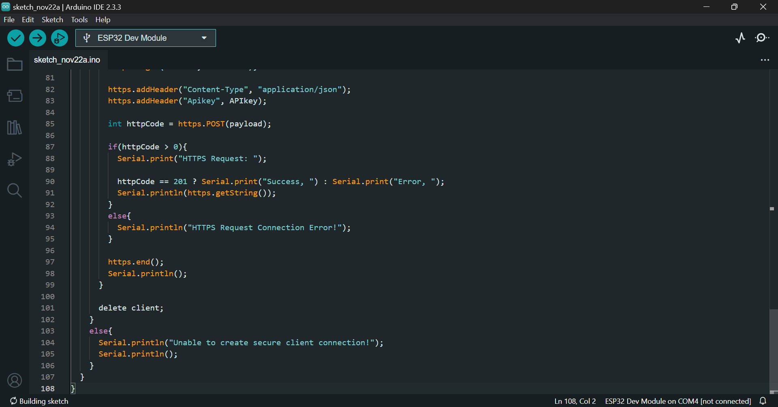
Then, open new sketch in Arduino ide. And paste the code.

Slide 31
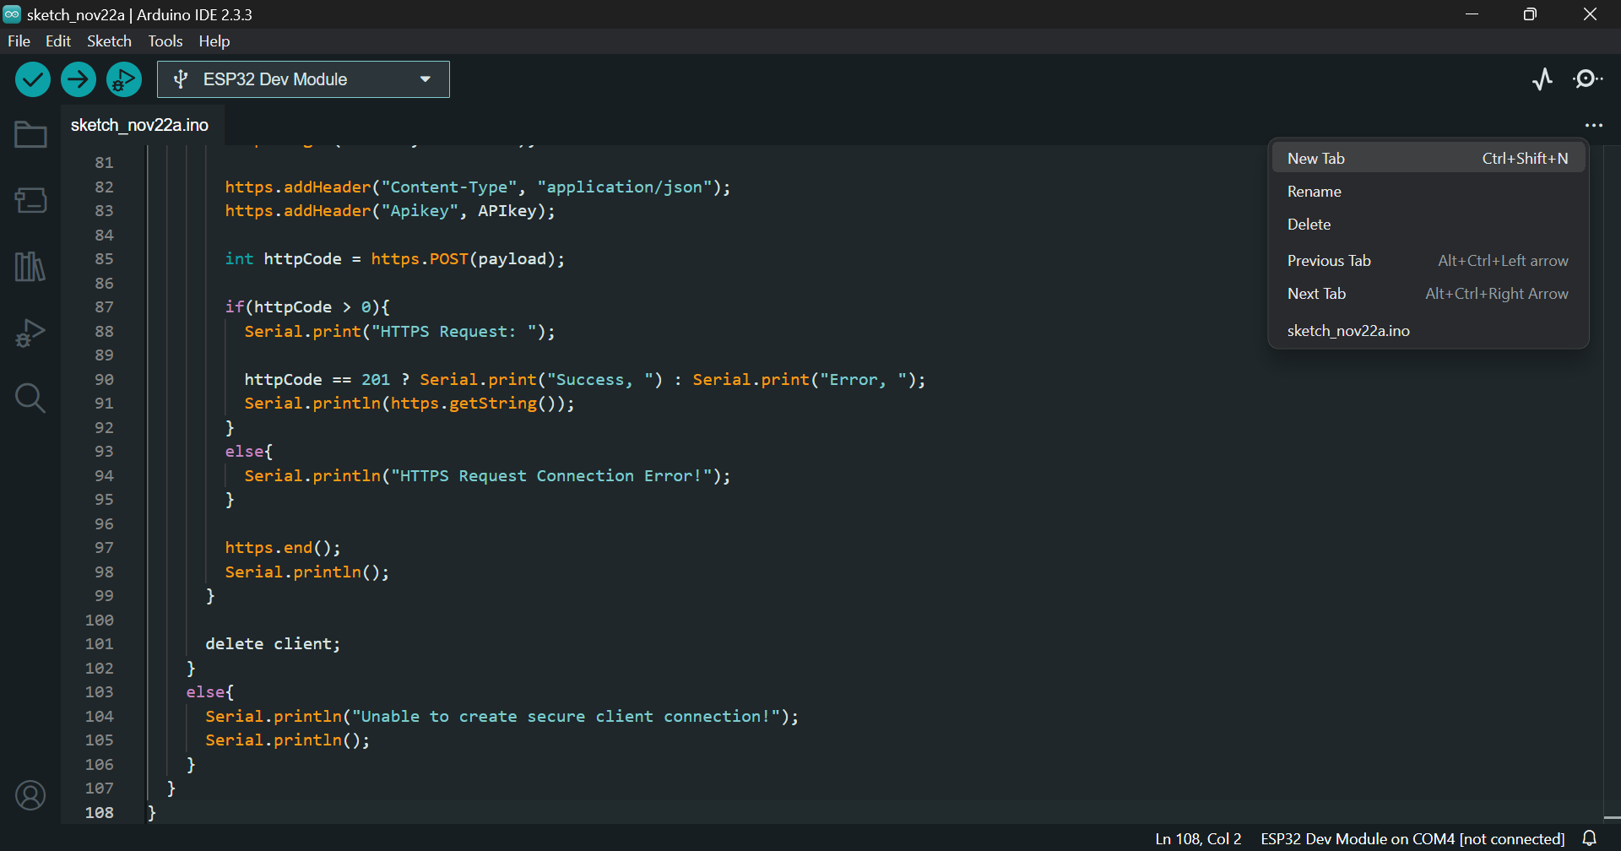
1
Create new tab for Favoriot certificate.

Slide 32
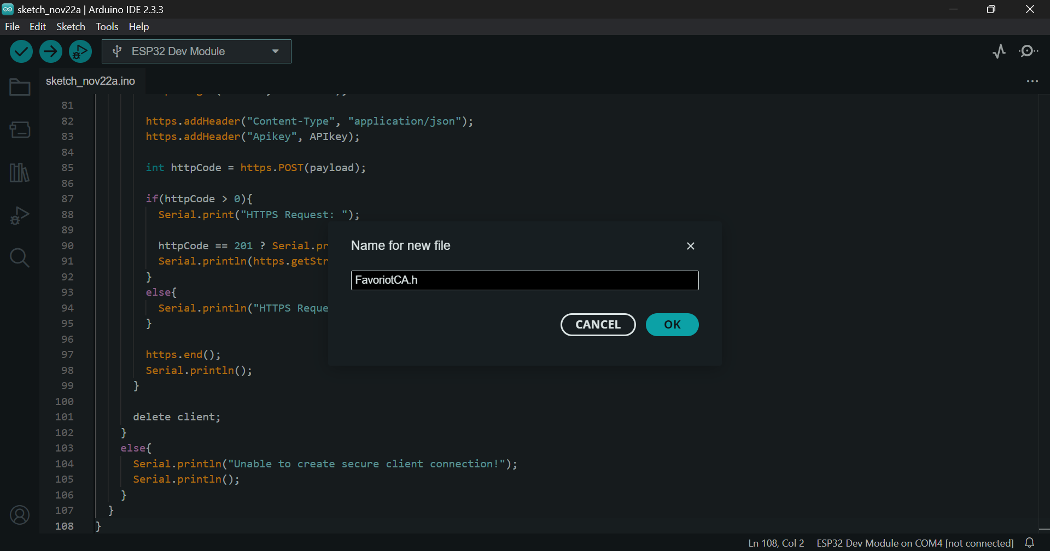
Name the file. Then, click OK.
1
2

Slide 33
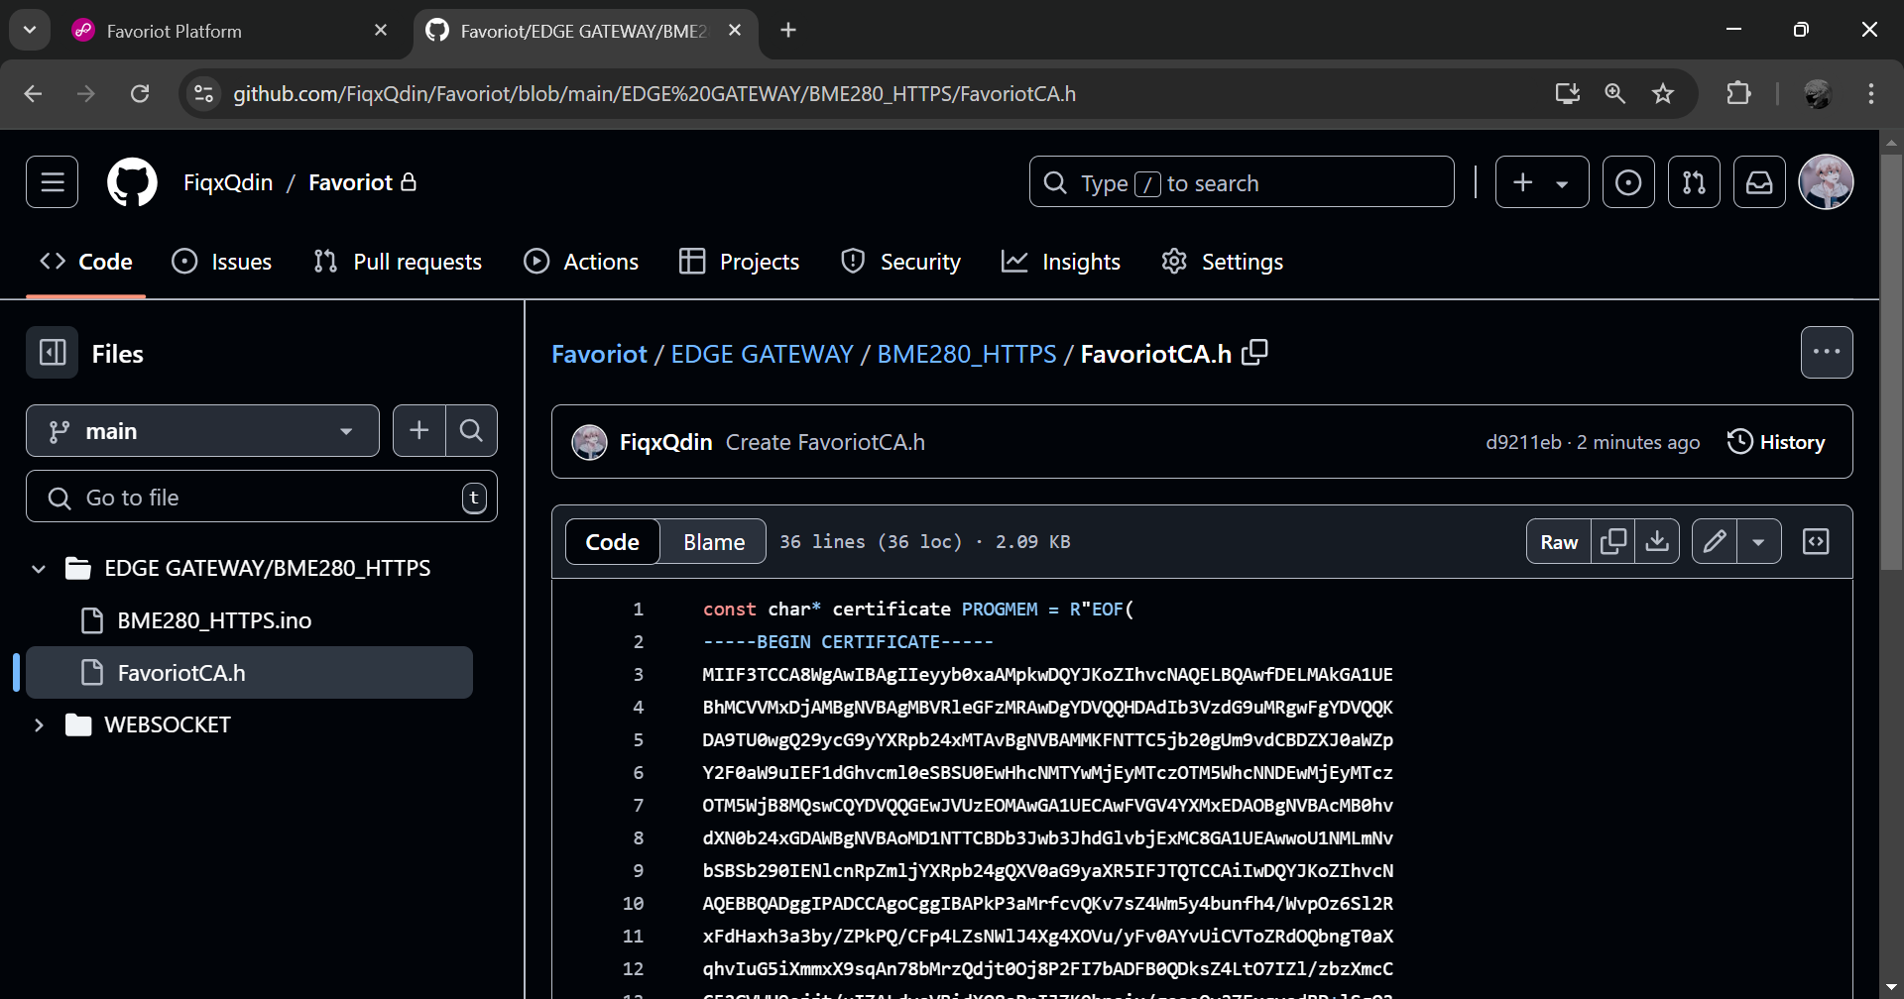
Open GITHUB (https://github.com/FiqxQdin/Favoriot/blob/main/EDGE%20GATEWAY/HIBISCUS%20SENSE%20ESP32/BME280_HTTPS/FavoriotCA.h). Then, copy the code.
1

Slide 34
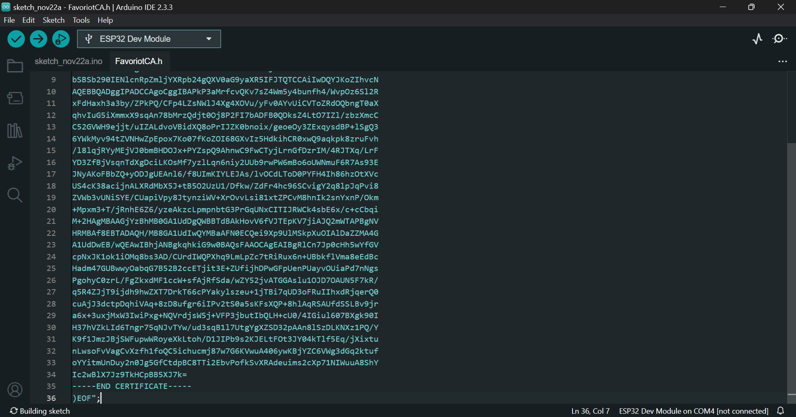
1
Open the sketch.

Slide 35
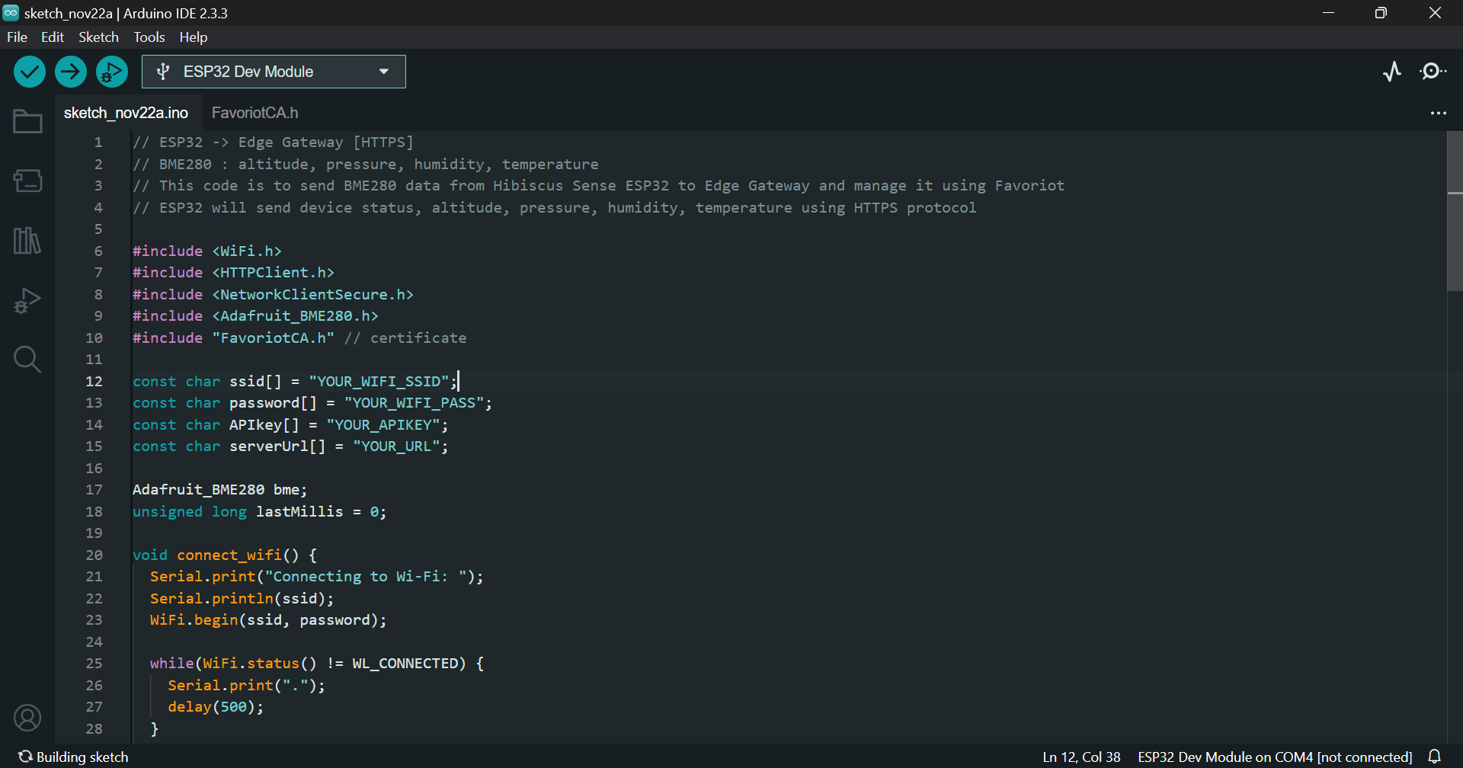
1
Change this to your Wi-Fi SSID, and Wi-Fi Password.
Then, insert your Gateway access token and URL.

Slide 36

View your gateway.
1

Slide 37
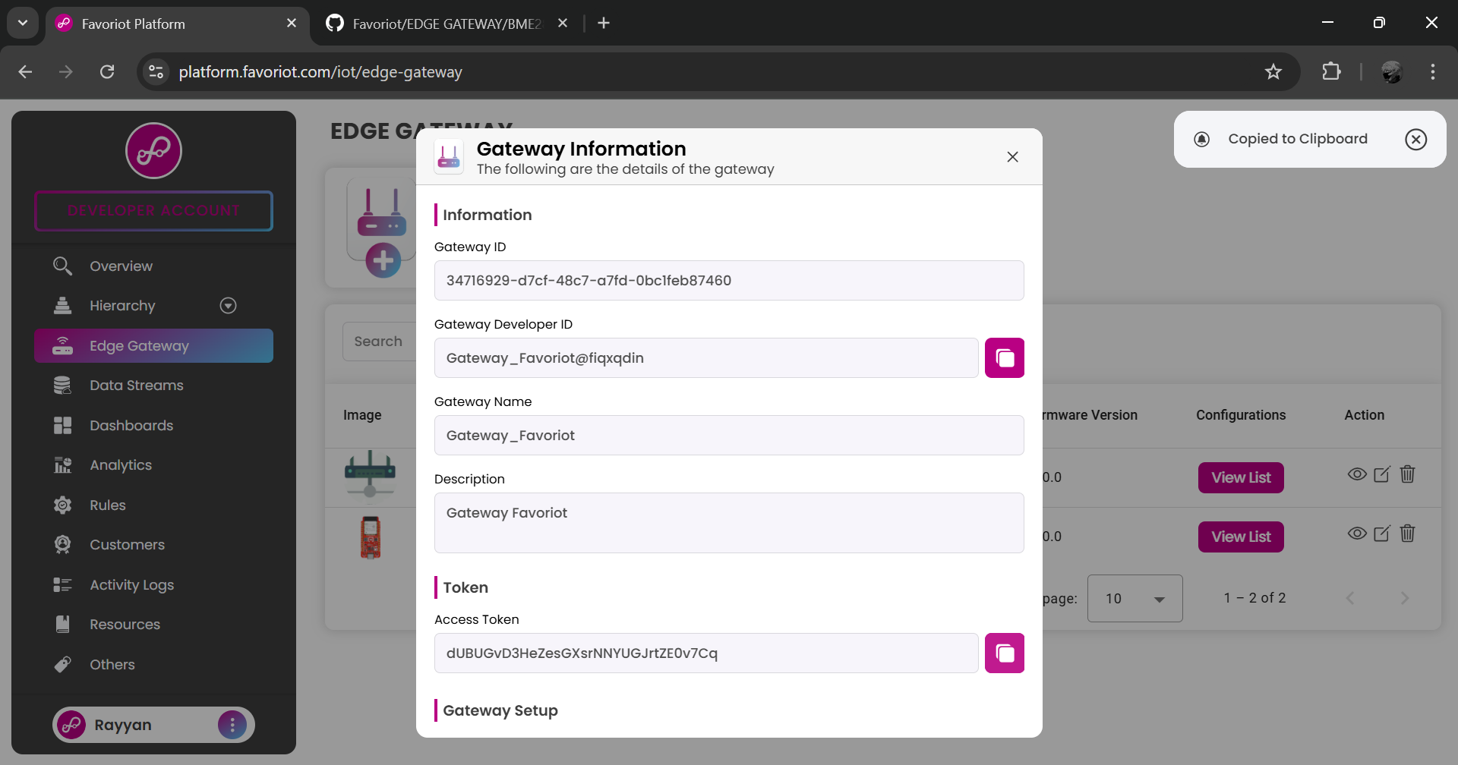
This access token is your APIKEY.
1

Slide 38
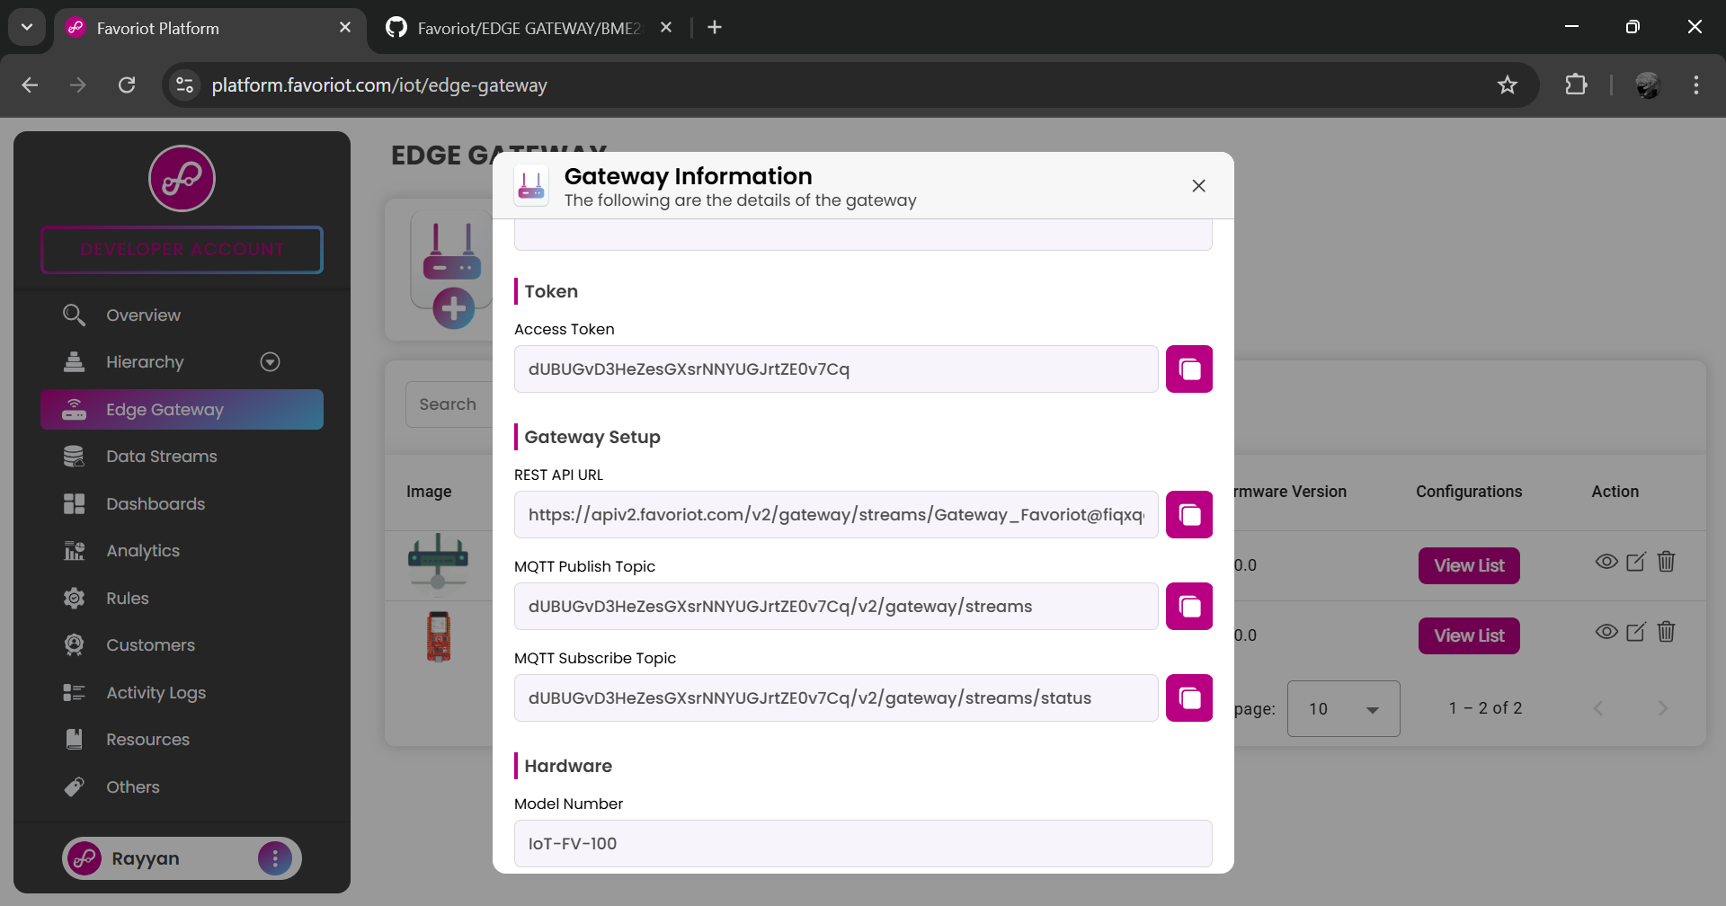
Scroll down to copy API URL.
1

Slide 39
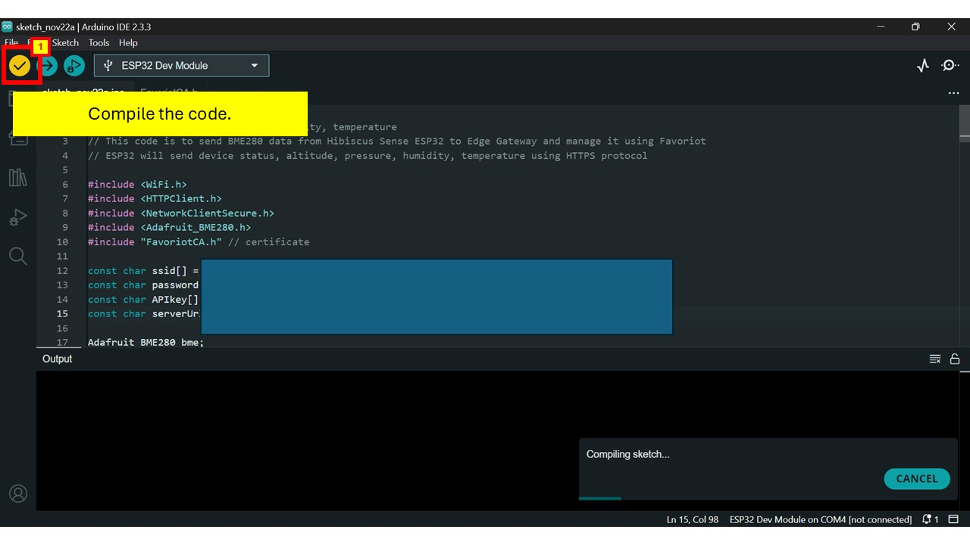

Slide 40
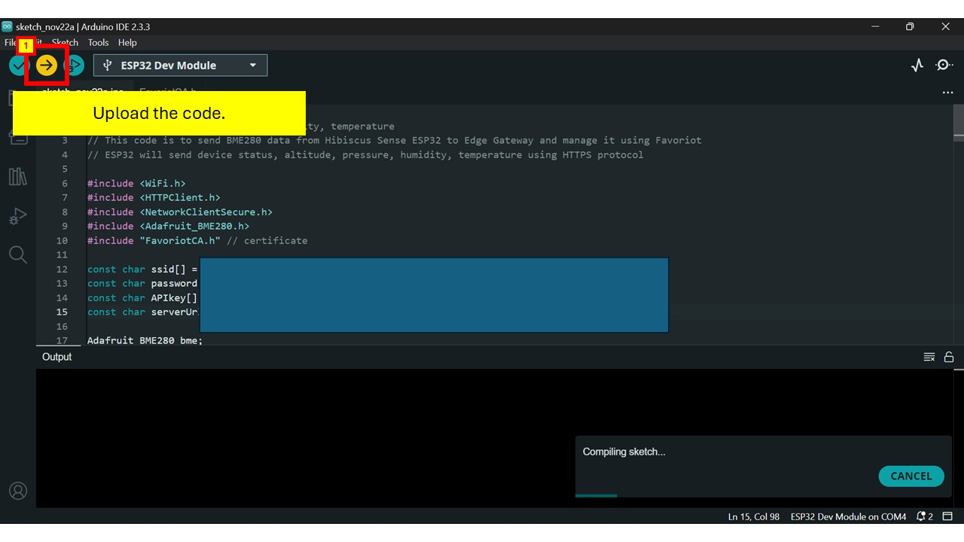

Slide 41
RASPBERRY PI SETUP

Slide 42
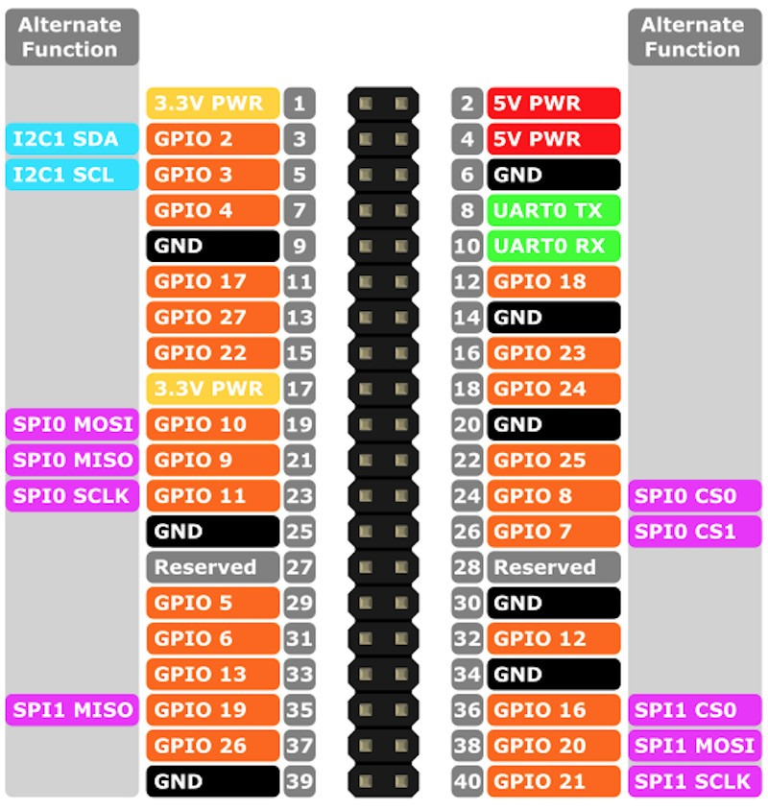
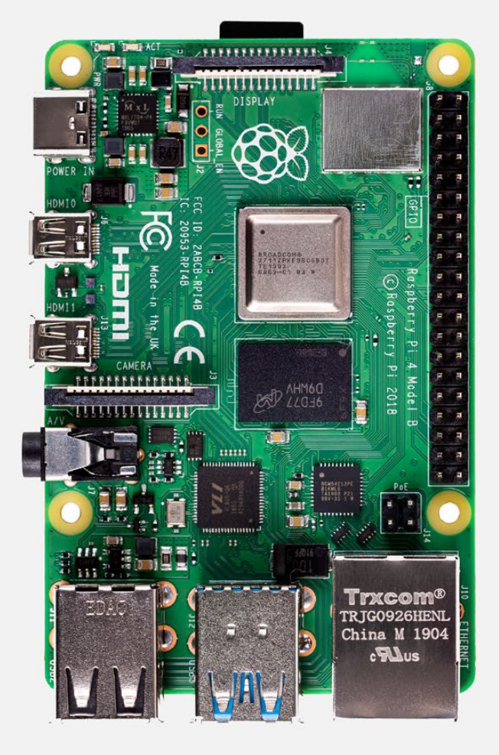

Slide 43
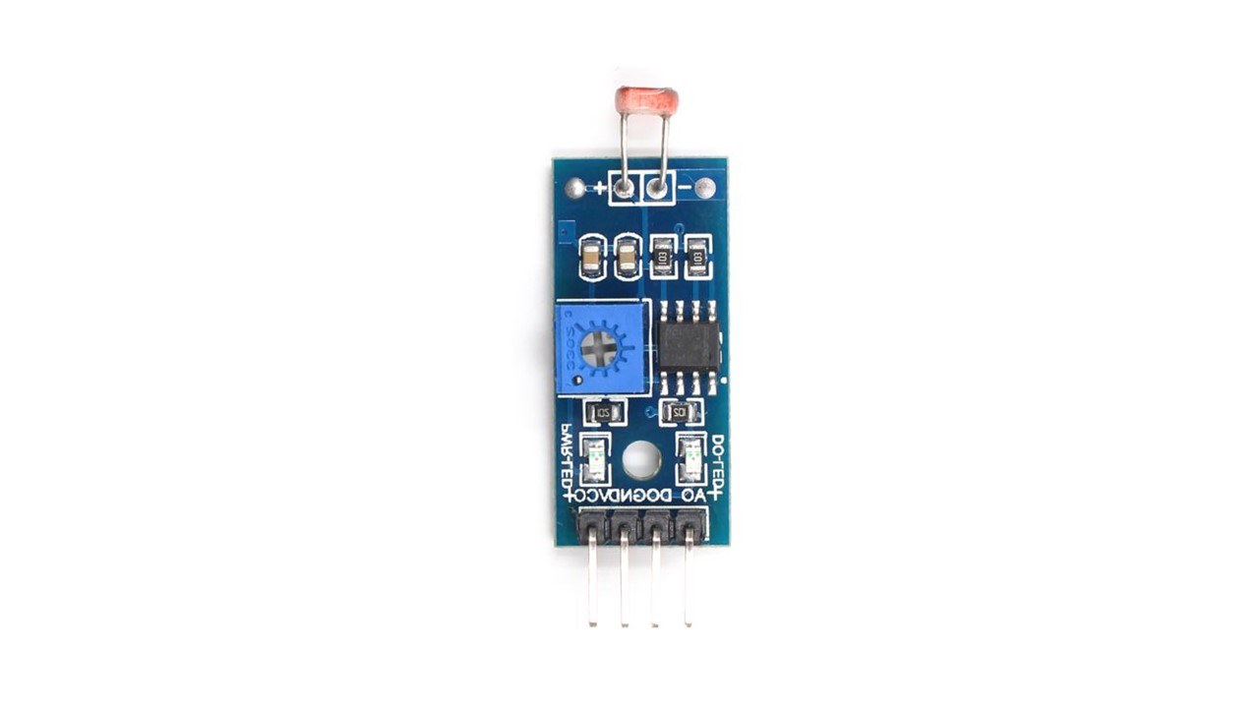
Connect light sensor to Raspberry Pi 4 Model B.
3.3V PWR
PLUG
GND
GPIO 2

Slide 44
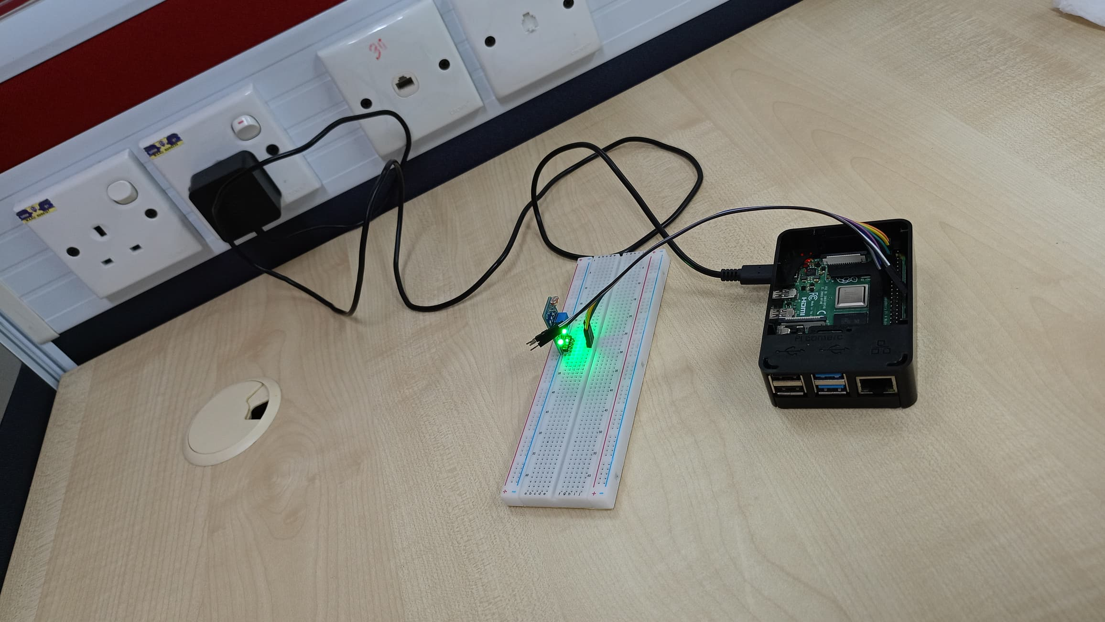
Then, connect Raspberry Pi to the plug.

Slide 45
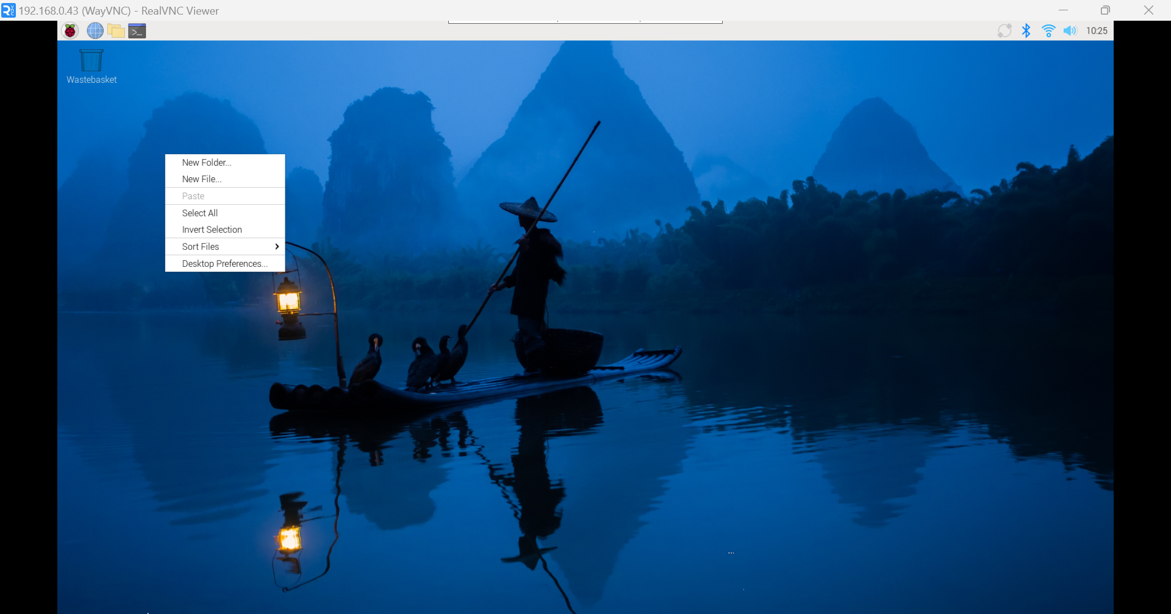
1
Open Raspberry Pi. Then, right-click on the mouse to create new file.

Slide 46
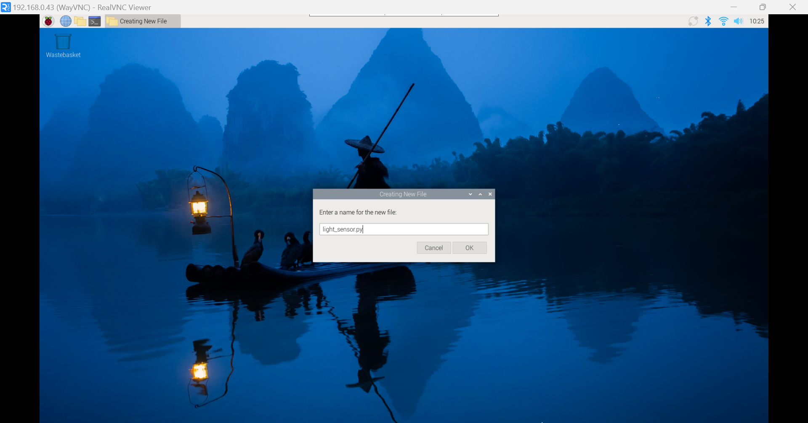
Name the python file.
1

Slide 47
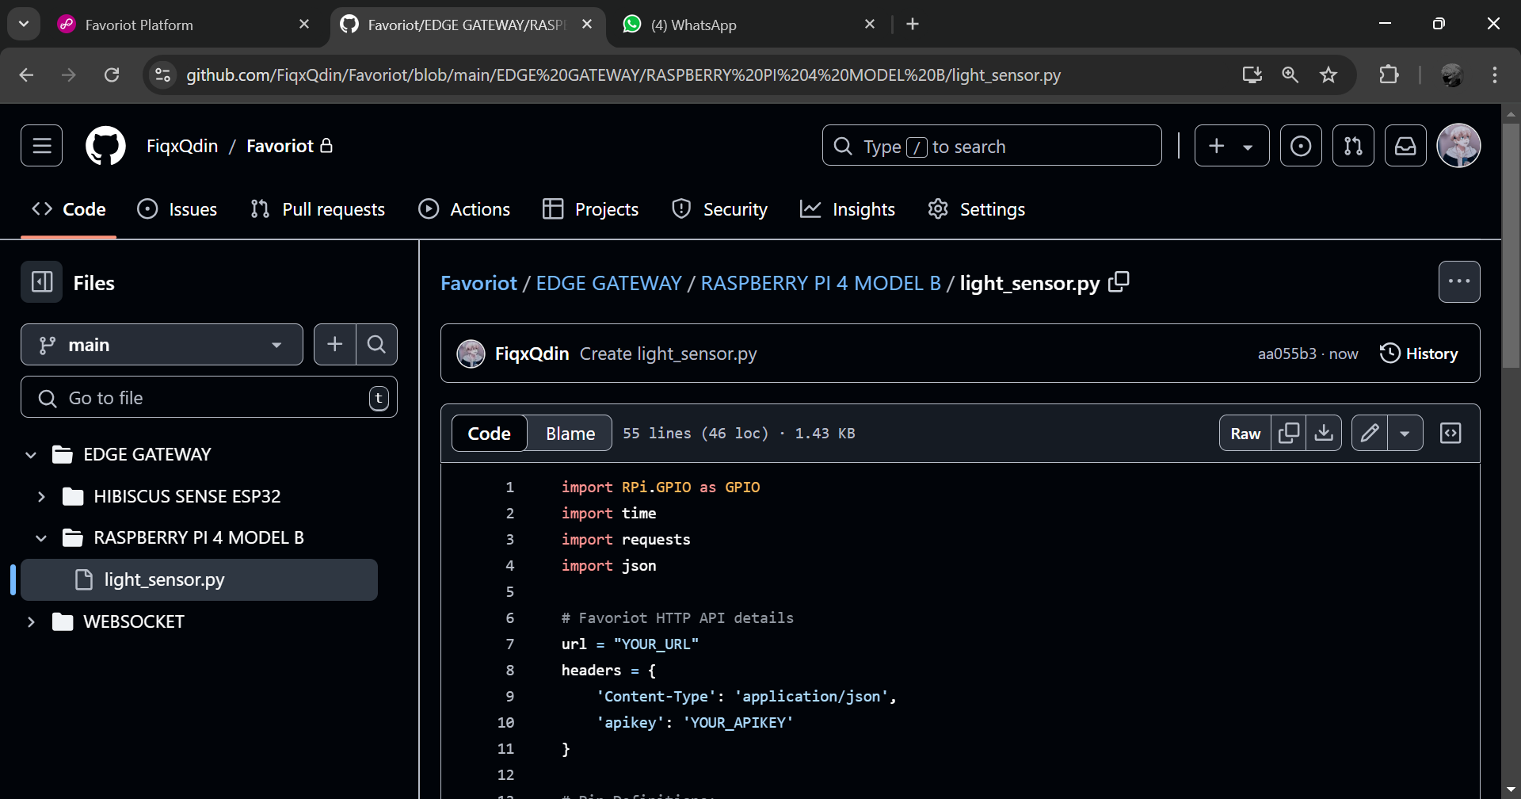
Open GITHUB (https://github.com/FiqxQdin/Favoriot/blob/main/EDGE%20GATEWAY/RASPBERRY%20PI%204%20MODEL%20B/light_sensor.py). Then, copy the code.
1

Slide 48
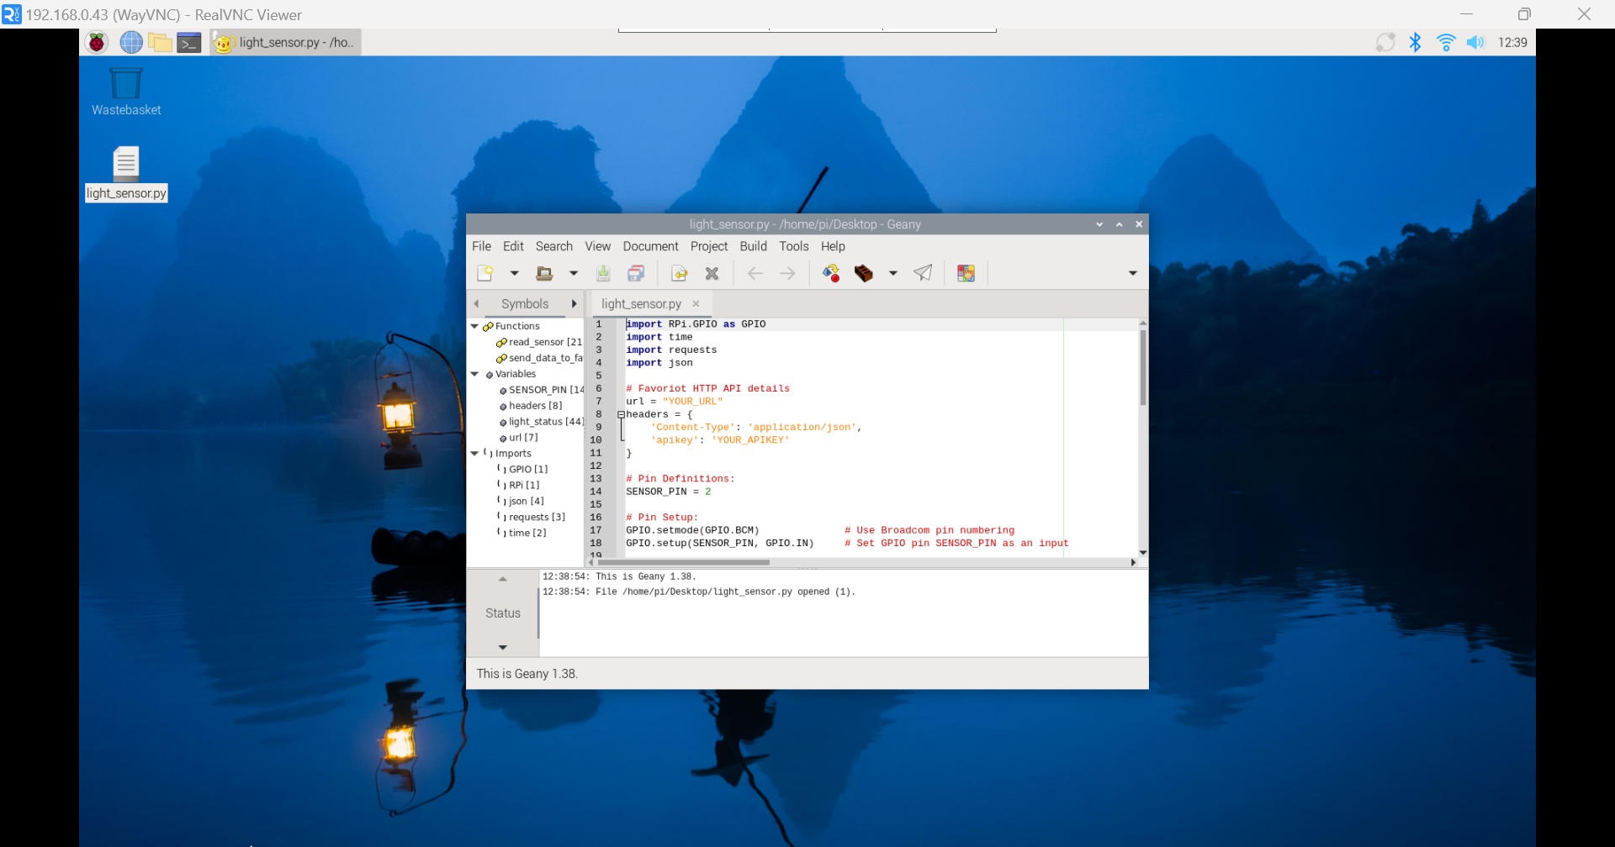
Paste the code. Then, maximize the window.
1

Slide 49
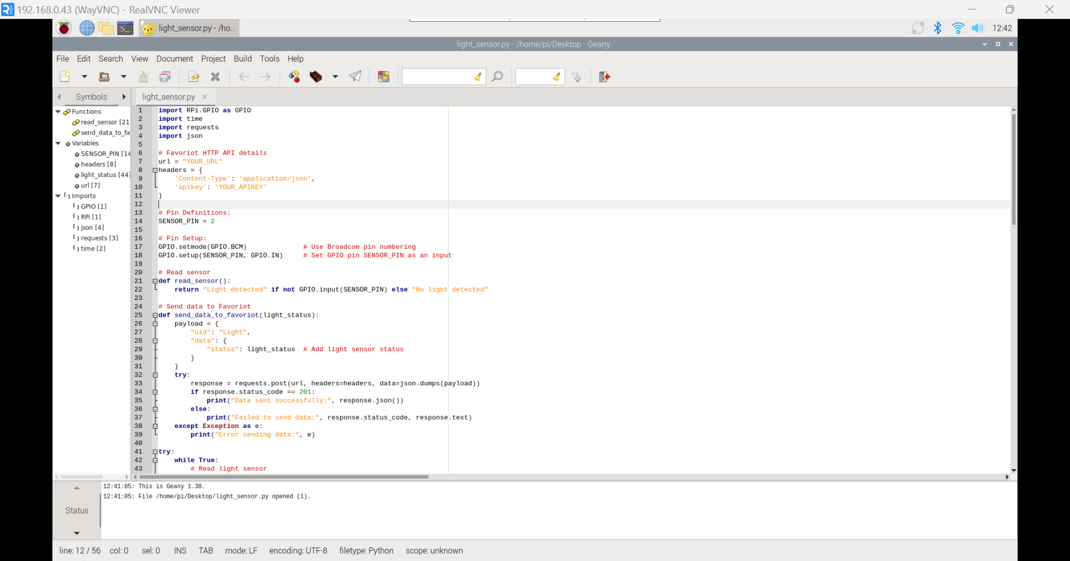
1
Change this to your gateway URL and Favoriot APIKEY.

Slide 50
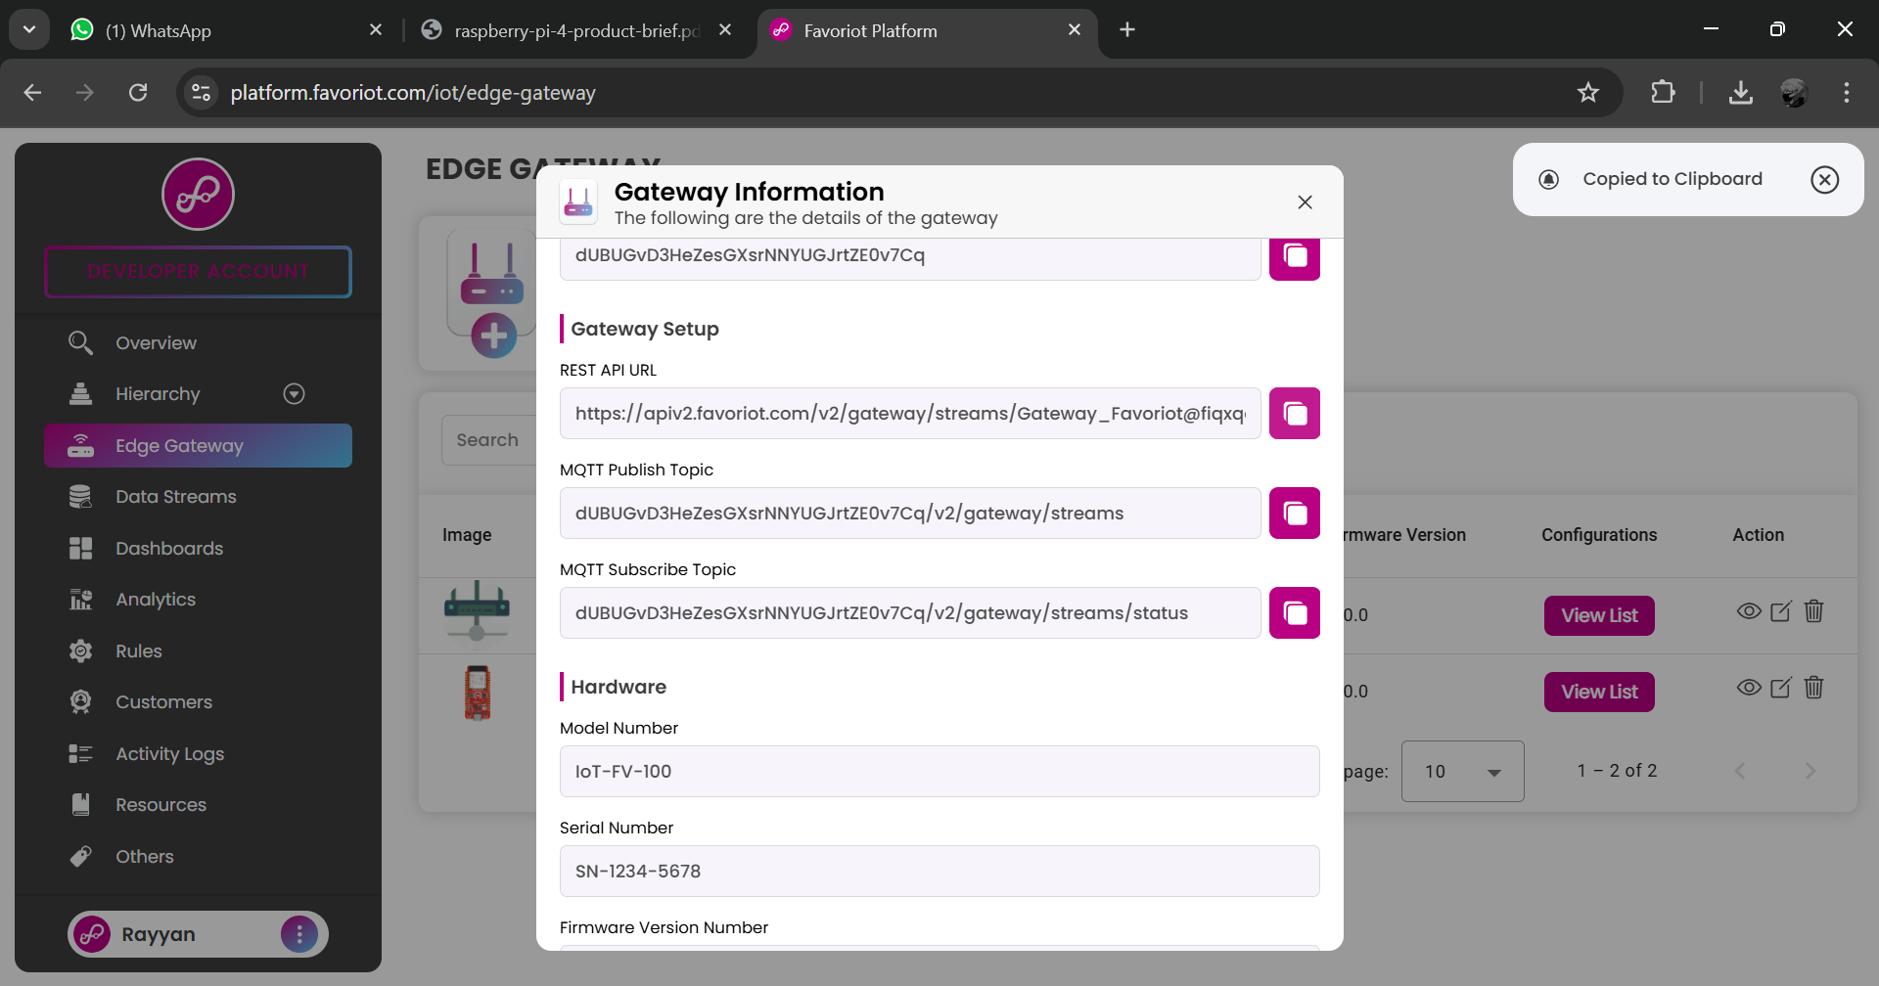
Copy the API URL.
1

Slide 51

1
Click developer account.

Slide 52
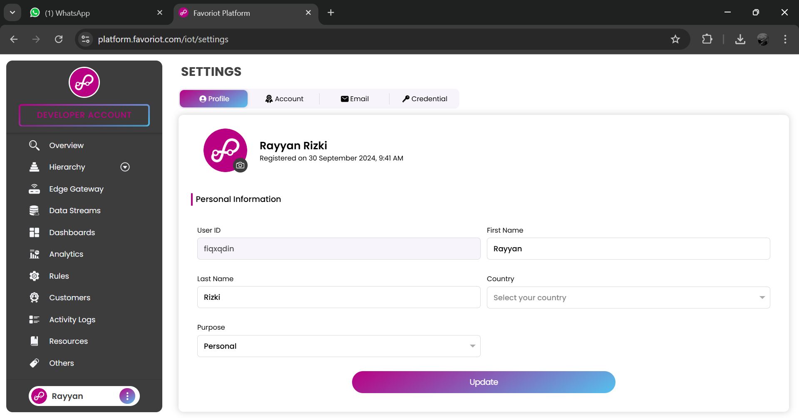
1
Click account.

Slide 53
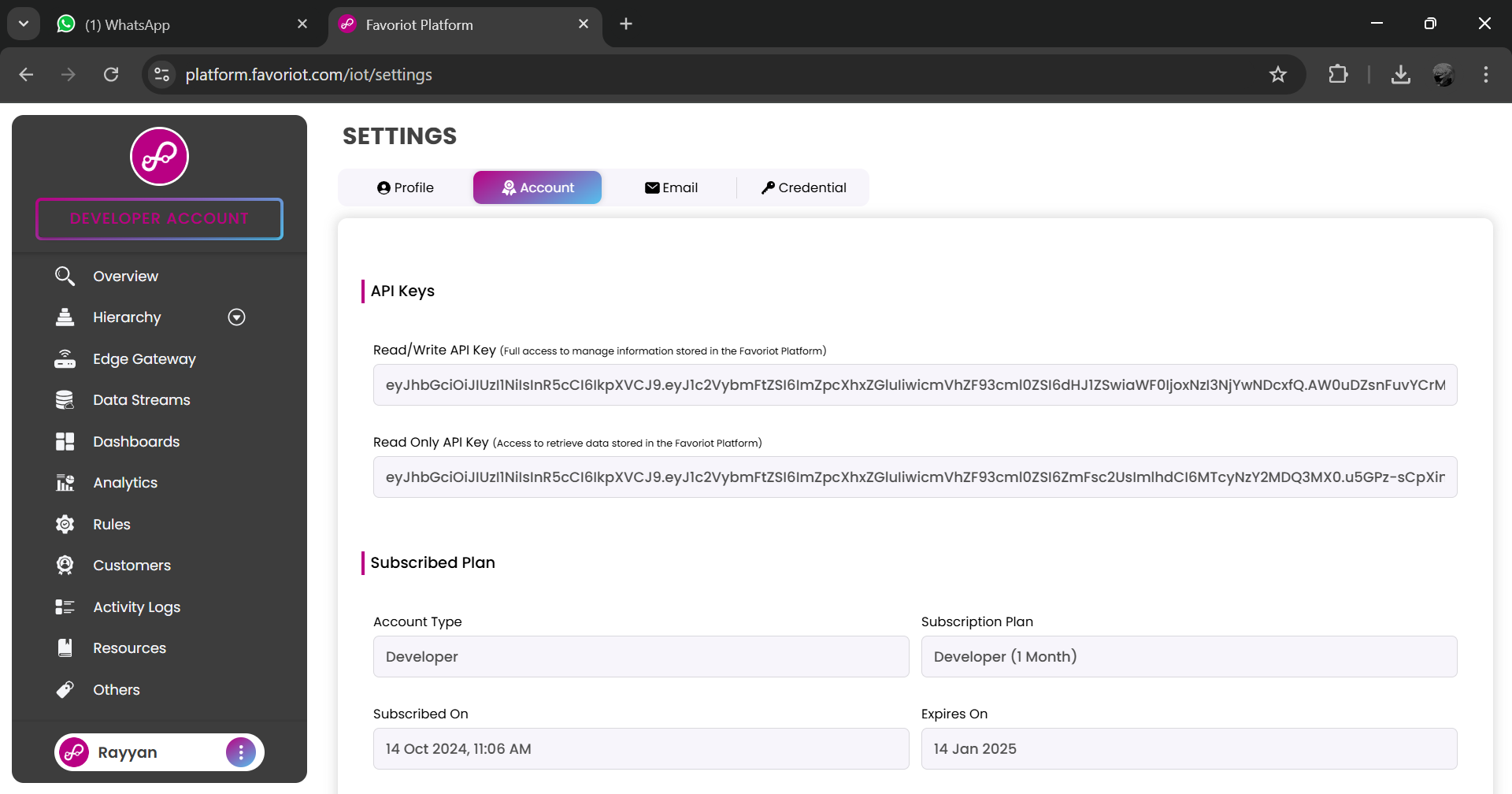
Then, copy the APIKEY.
1

Slide 54
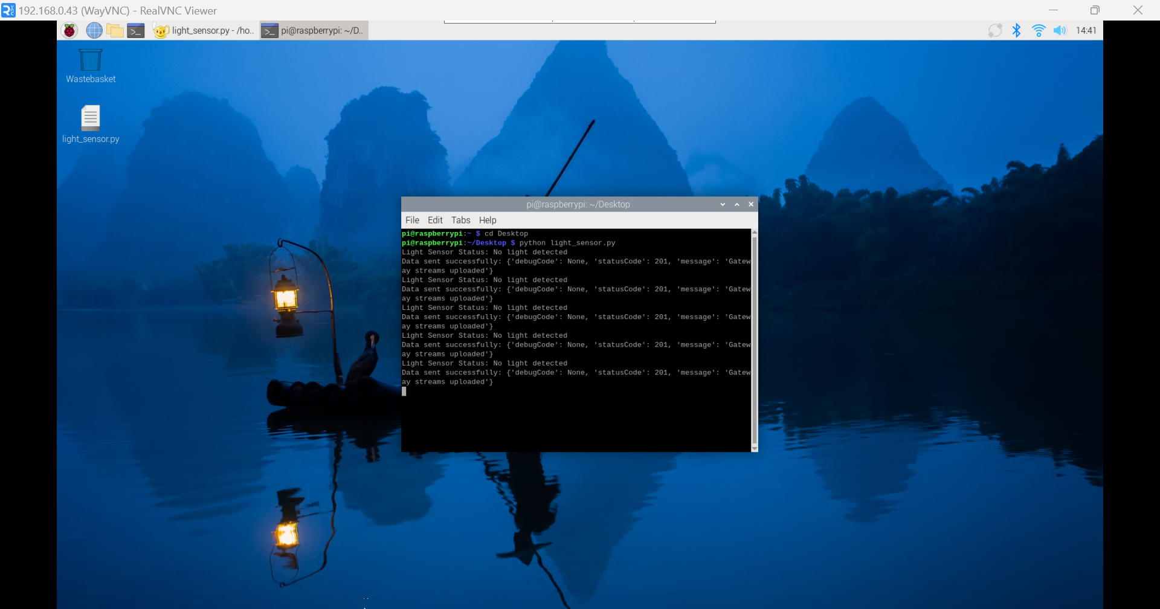
1
Open Terminal.
Go to desktop directory. Then, run the python code.
2
3
This 201 means that the light sensor status is successfully sent to data stream.

Slide 55
GATEWAY CONSOLE

Slide 56
1
Then, click edge gateway.
2
Then, view list.

Slide 57

1
Click console to see the payload.

Slide 58
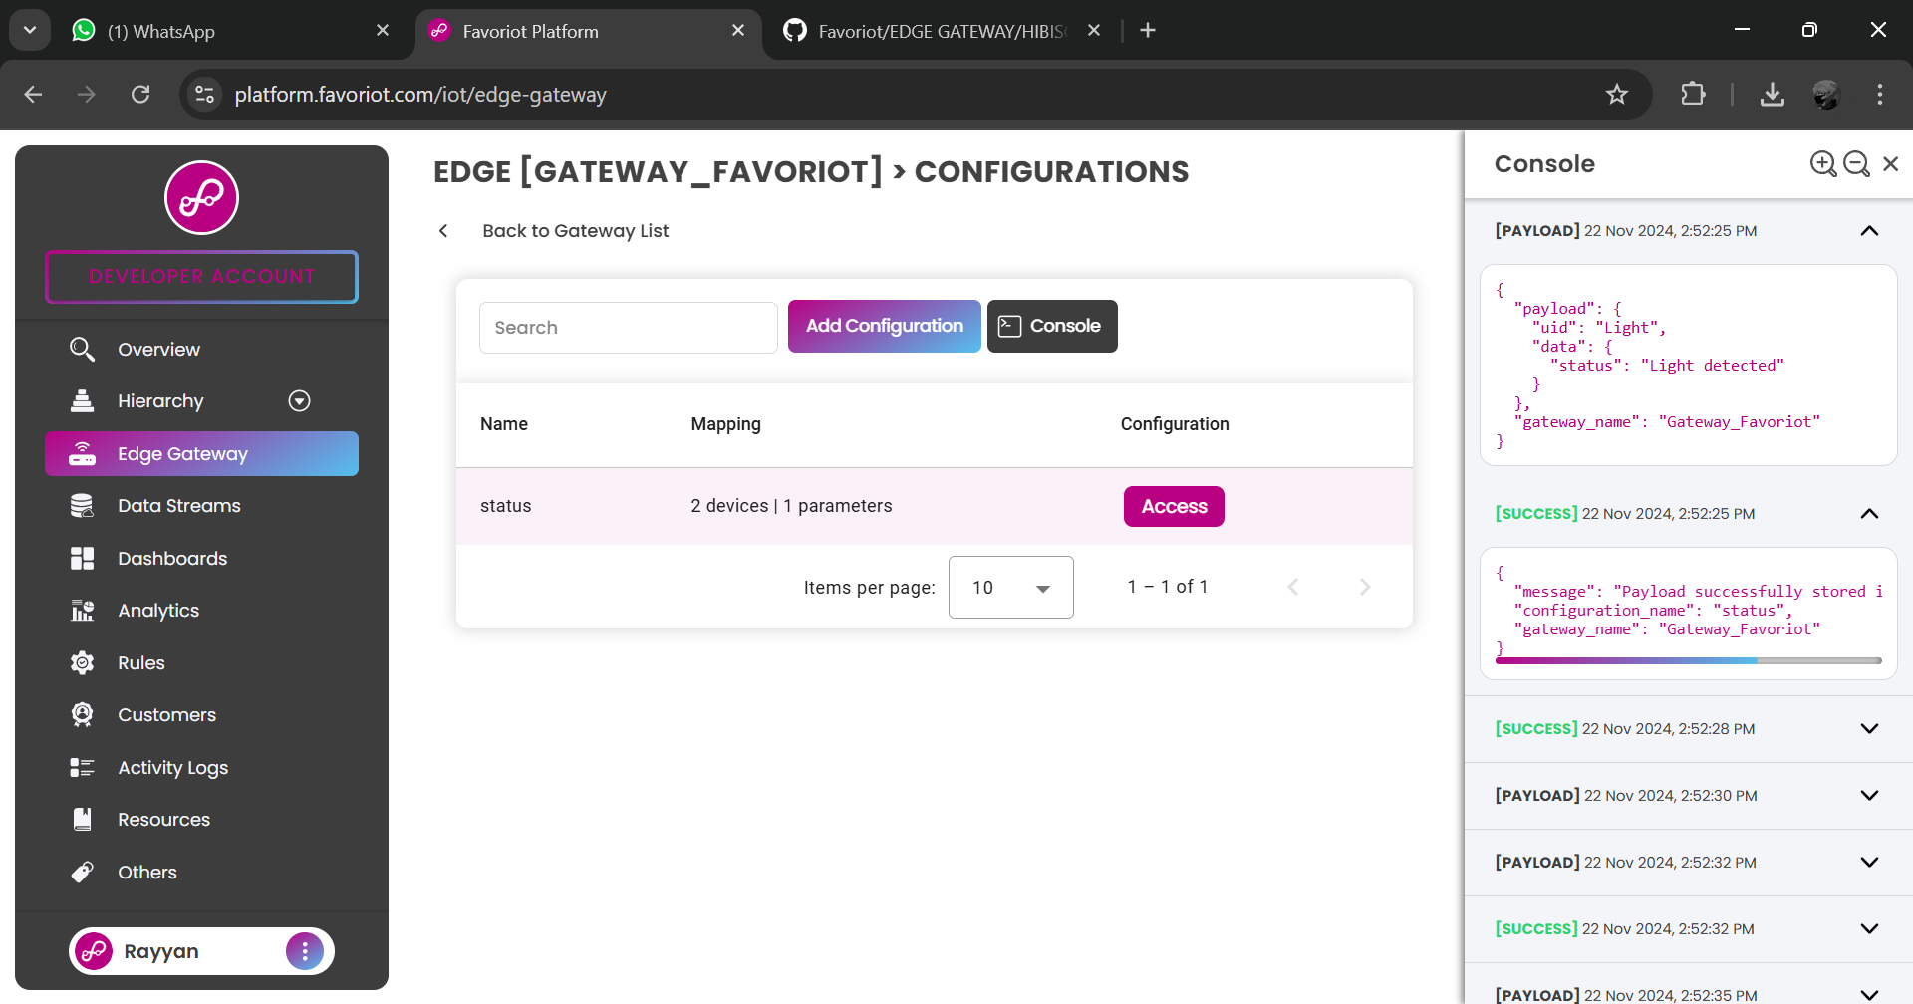
1
This is the payload sent from Raspberry Pi.

Slide 59

1
This is payload sent from ESP32. But only the status will be sent to Data streams.

Slide 60

This is the data sent from device through edge gateway.
1

